Slide 1
Optimal Distribution of Electric Vehicles Charging Stations
Presented by Haoting Ge, Noah Garfinkle, and Ximi Qu (Group Three) for CEE 512: Logistics Systems Analysis
Presented on 11 December 2019

Slide 2
Motivation
Motivation
Background
Problem Formulation
Results
Case Study
Discussion
Haoting Ge, Noah Garfinkle, and Ximi Qu | CEE 512: Logistics Systems Analysis | Slide 2 of 40
Notes:
Ximi

Slide 3
Motivation and Academic Significance
Freight delivery via semi-trucks is the foundation of many logistic networks in the United States.
Semi-trucks emit 16 percent of corporate greenhouse gasses and pose substantial fuel costs for logistics systems. [1]
Electric semi-trucks are now entering the market, with some countries specifying ambitious targets to replace all trucks with electric vehicles. [1]
Differing ‘refueling’ requirements of electric vs. diesel semi-trucks may require modification of routing timetables to enable charging.
http://business.edf.org/projects/green-freight-facts-figures
Motivation
Background
Problem Formulation
Results
Case Study
Discussion
Haoting Ge, Noah Garfinkle, and Ximi Qu | CEE 512: Logistics Systems Analysis | Slide 3 of 40

Slide 4
Project Objectives
The objective of this research project is to:
Learn how to implement coupled variants of the routing and facility location models learned in class
Explore tradeoffs between:
Route efficiency
Cost of installation and operation of new recharging infrastructure
Motivation
Background
Problem Formulation
Results
Case Study
Discussion
Haoting Ge, Noah Garfinkle, and Ximi Qu | CEE 512: Logistics Systems Analysis | Slide 4 of 40

Slide 5
Background
Motivation
Background
Problem Formulation
Results
Case Study
Discussion
Haoting Ge, Noah Garfinkle, and Ximi Qu | CEE 512: Logistics Systems Analysis | Slide 5 of 40
Notes:
Haoting

Slide 6
Literature review
What is a Location Routing Problem (LRP)?
What is LRP trying to solve?
How many facilities to locate,
Where to locate facilities,
How to assign customers to facilities
How to route vehicles to serve customers
Two step decision making
Strategic Decision: the optimal number, the capacity, and the location of facilities
Operational Decision: the optimal set of vehicle routes from fixed facilities decided in step 1
The main difference between LRP and what we learned in class is that we must assign optimal depot locations simultaneously to evaluating optimal routing
Motivation
Background
Problem Formulation
Results
Case Study
Discussion
Haoting Ge, Noah Garfinkle, and Ximi Qu | CEE 512: Logistics Systems Analysis | Slide 6 of 40

Slide 7
Literature review
Solution Approaches
Location Routing Problem
Exact Solutions
Heuristic Algorithms
Metaheuristic Algorithms
Motivation
Background
Problem Formulation
Results
Case Study
Discussion
Haoting Ge, Noah Garfinkle, and Ximi Qu | CEE 512: Logistics Systems Analysis | Slide 7 of 40

Slide 8
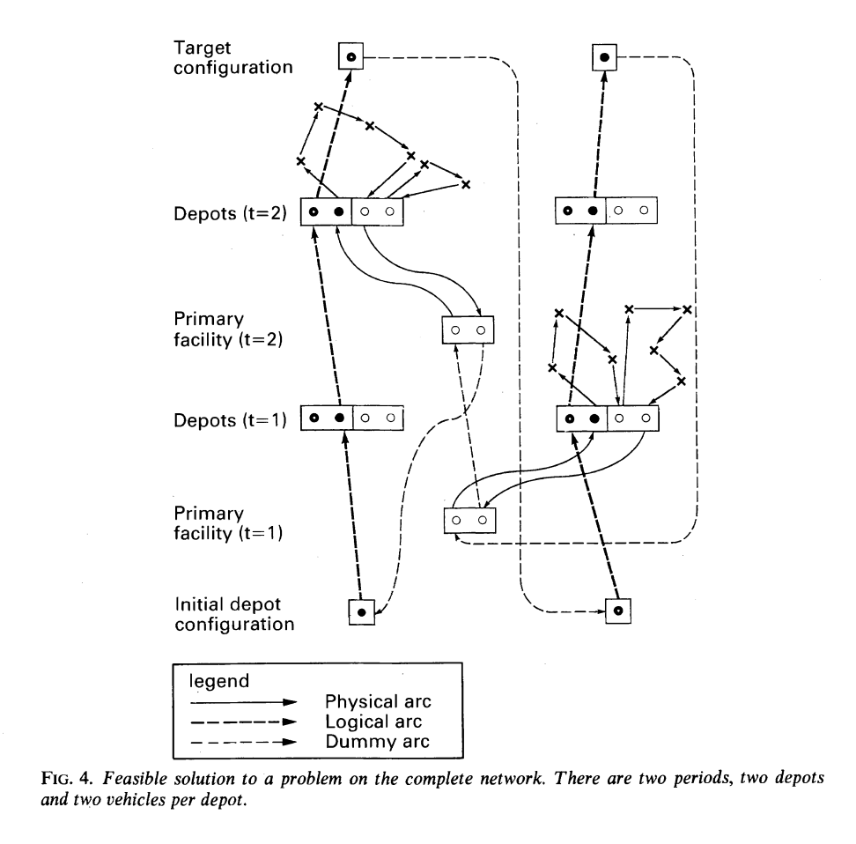
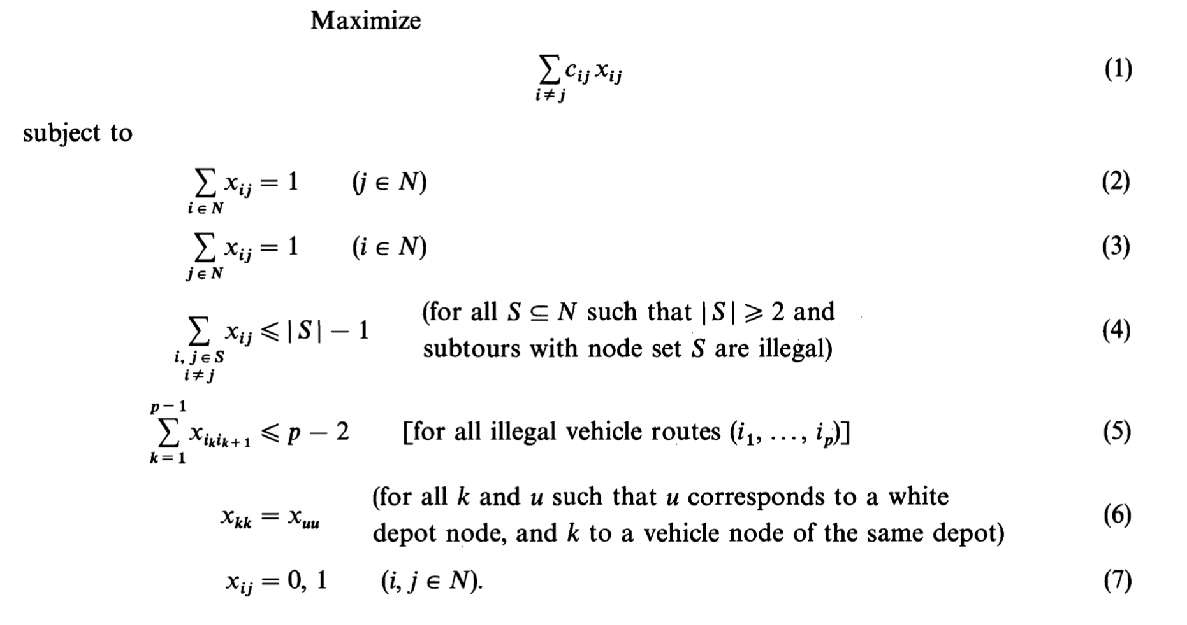
Literature review
Exact Solution
A number of exact algorithms were presented in Laporte’s (1983) paper. [5]
Integer programming exact algorithms (Laporte, 1989) [6]
Three-layer system
Motivation
Background
Problem Formulation
Results
Case Study
Discussion
Haoting Ge, Noah Garfinkle, and Ximi Qu | CEE 512: Logistics Systems Analysis | Slide 8 of 40

Slide 9
Literature review
Heuristic Algorithms
The exact solution for LRP is NP-hard problem.
A bunch of heuristic algorithms were reviewed by Madsen (1983).
Maria (2005) proposed a two-phase heuristic:
First phase: Decide the set of facilities and consider priori routes.
Second phase: Optimize the routes
Metaheuristic Algorithms
Tabu Search
Simulated Annealing
Genetic Algorithms
Motivation
Background
Problem Formulation
Results
Case Study
Discussion
Haoting Ge, Noah Garfinkle, and Ximi Qu | CEE 512: Logistics Systems Analysis | Slide 9 of 40

Slide 10
Case Study
Motivation
Background
Problem Formulation
Results
Case Study
Discussion
Haoting Ge, Noah Garfinkle, and Ximi Qu | CEE 512: Logistics Systems Analysis | Slide 10 of 40
Notes:
Ximi

Slide 11
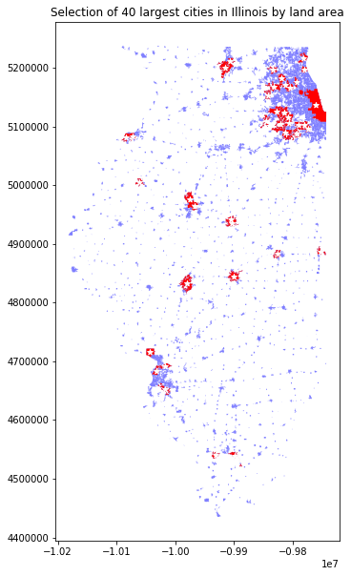
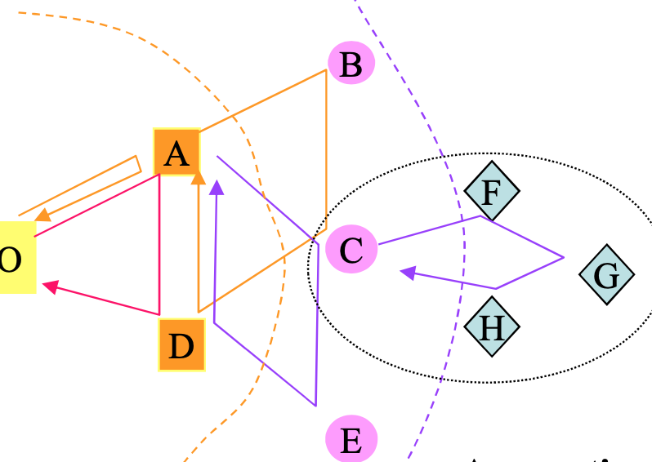
Case Study Background
Electric Semi-Truck Freight Delivery Model
Our study focuses on creating a general model to integrate electric semi-trucks into an existing freight delivery network.
Since the electric semi-truck’s ‘fueling time’ and charging station setup are more costly compared to the traditional diesel semi-truck. We are looking for the most economical way to minimize those trade-offs.
Besides, we are generating a model for the middle hierarchy of the transshipment between terminals.
Motivation
Background
Problem Formulation
Results
Case Study
Discussion
Haoting Ge, Noah Garfinkle, and Ximi Qu | CEE 512: Logistics Systems Analysis | Slide 11 of 40

Slide 12
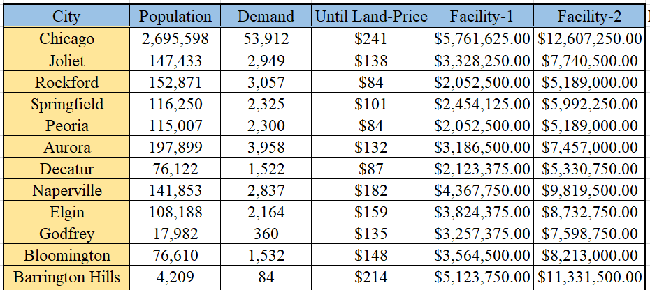
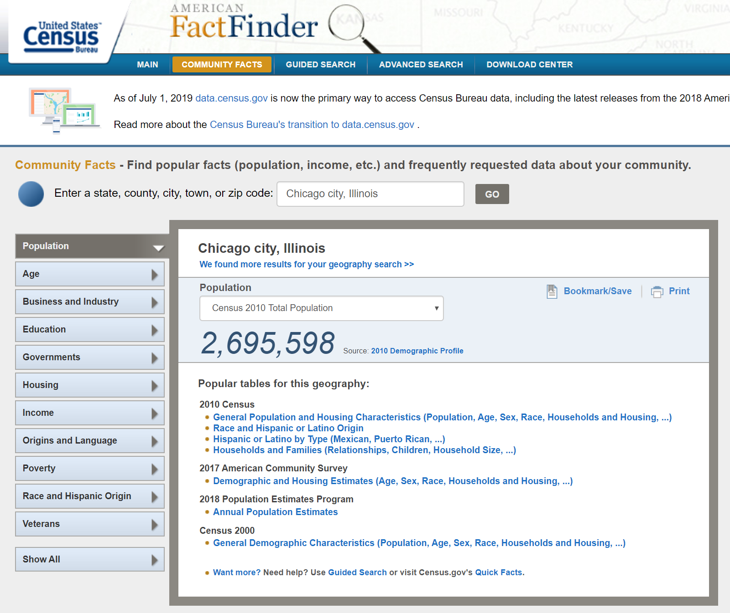
Case Study Data Preparation
Selection of the Cities
The case study is based in Illinois. According to the geographic size of each city and due to the problem’s formulation, 40 cities were selected.
Demand
We have assumed that demand is proportional to the population of each city, expressed in pounds of shipment.
https://factfinder.census.gov/faces/nav/jsf/pages/community_facts.xhtml?src=bkmk
Motivation
Background
Problem Formulation
Results
Case Study
Discussion
Haoting Ge, Noah Garfinkle, and Ximi Qu | CEE 512: Logistics Systems Analysis | Slide 12 of 40

Slide 13
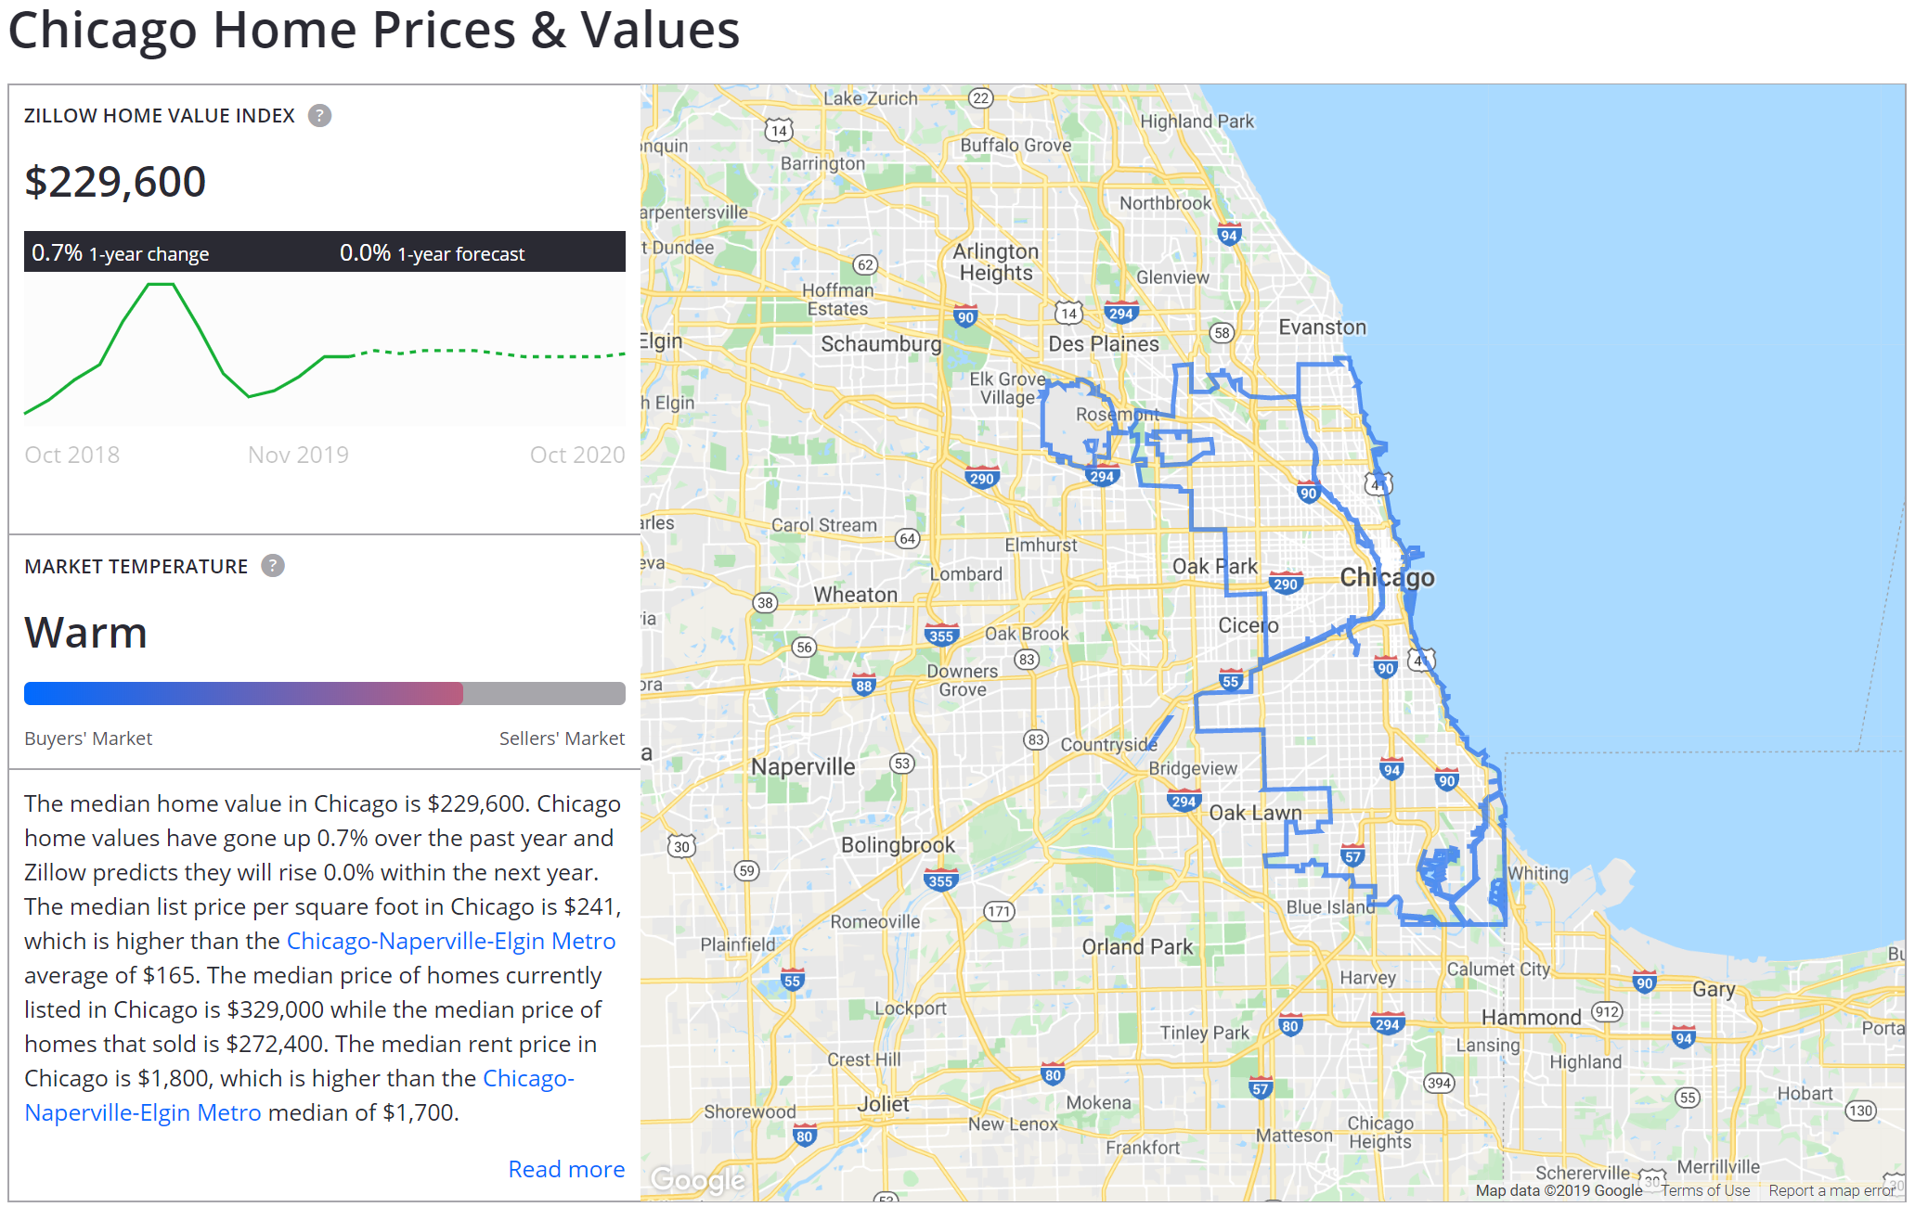
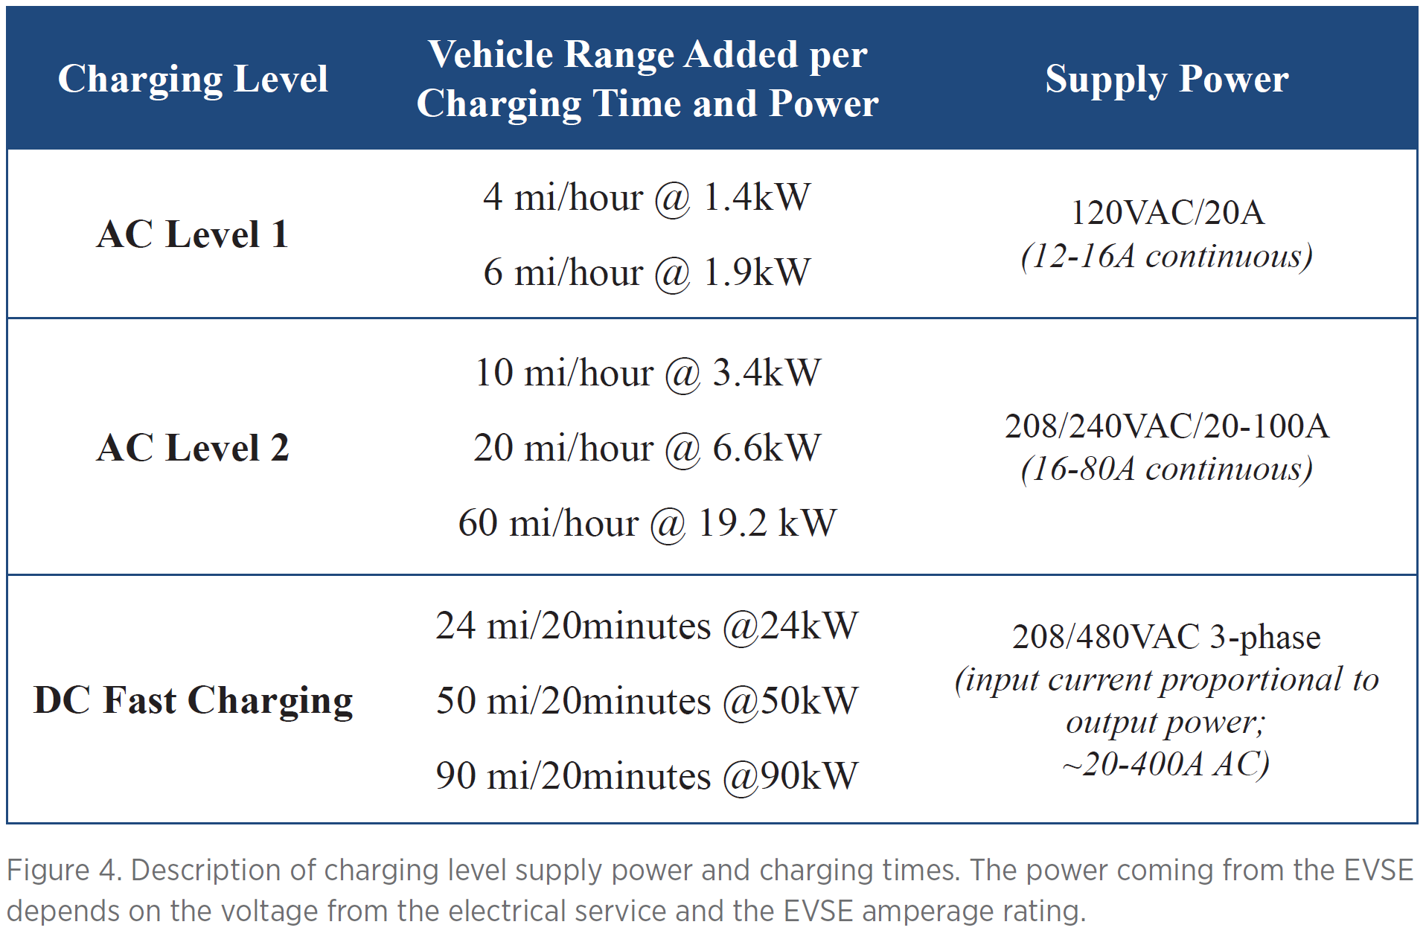
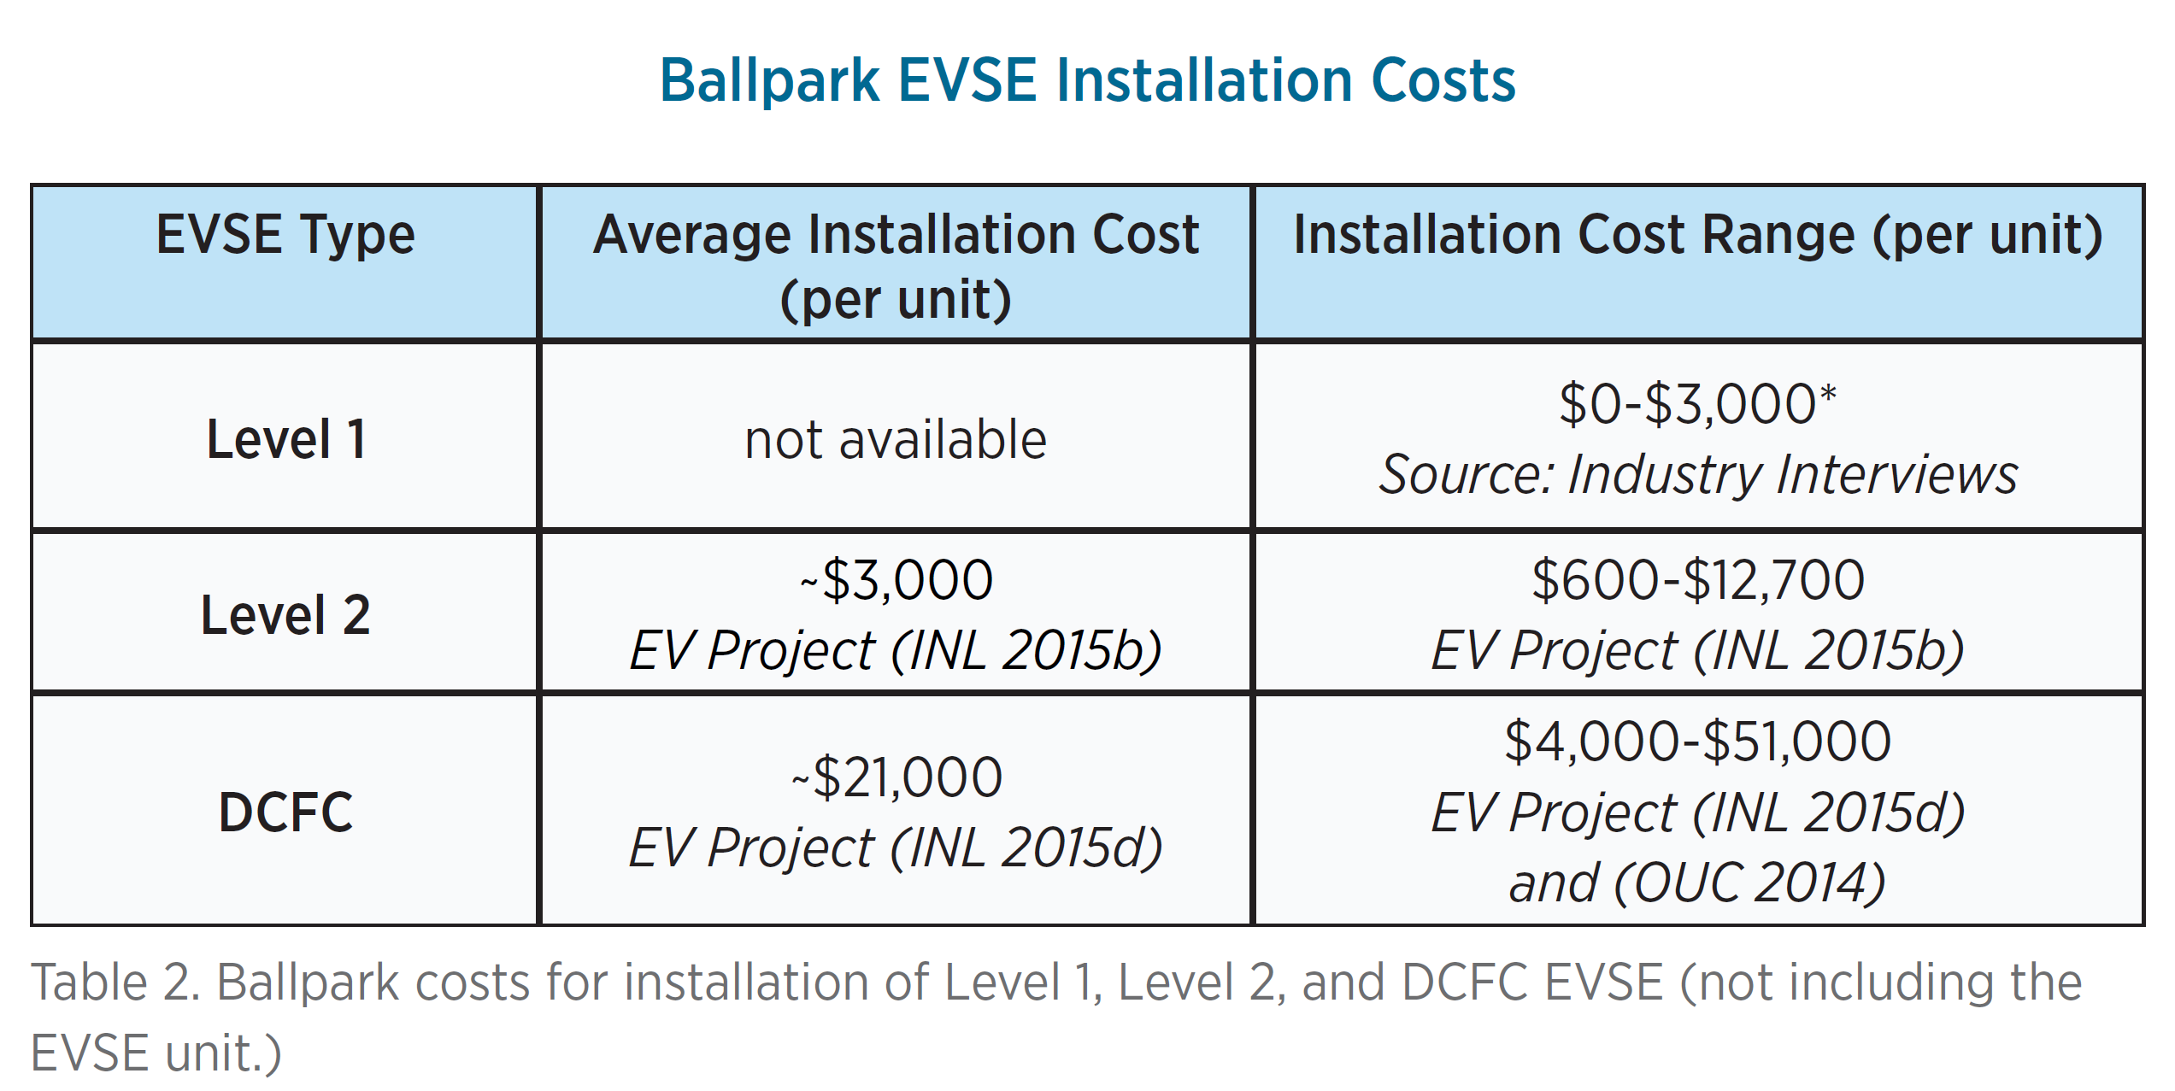
Case Study Data Preparation
In this study case, one of the objectives is to determine where the add-on charging facility should be built to the existing terminals. There will be two types of charging facility to serve two different types of trucks.
Facility Cost
Including two major components:
Land Cost
The charging facility is considered to be a new addition to the existing terminals. The unit price of the land ($/ft^2) is based on the Zillow's house pricing.
Charging Instrument Cost
Based on the “Costs Associated With Non-Residential Electric Vehicle Supply Equipment” from the U.S. Department of Energy for estimation.
https://www.zillow.com/chicago-il/home-values/
Due to the need of efficiency of the charging speed and quantity of the battery, the AC Level 2 and DC Fast Charging are used as our two types of facility-based model.
Motivation
Background
Problem Formulation
Results
Case Study
Discussion
Haoting Ge, Noah Garfinkle, and Ximi Qu | CEE 512: Logistics Systems Analysis | Slide 13 of 40

Slide 14
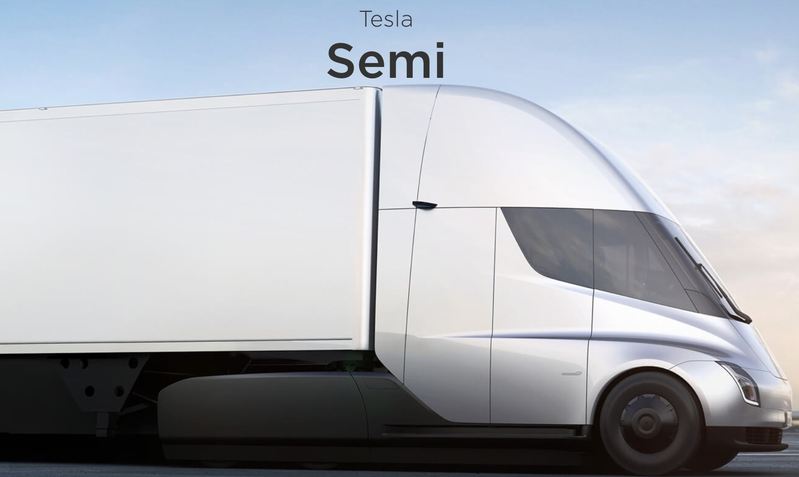
Case Study Data Preparation
 | Truck type 1 | Truck type 2
Range (kilometers) | 240 | 640
Capacity (lbs) | 40,000 | 80,000
Vehicle Parameters
Ranges
The range of fully charged electric trucks. In our model, we set two different types of electric trucks. The smaller one has a range of 240 kilometers, while the larger one has a range of 640 kilometers.
Capacities
The maximum weight can be carried by an electric truck. The capacities of electric trucks are based on different kinds of internal combustion engine trucks. They are set to be 80,000 lbs (equivalent to a regular semi-trailer truck) and 40,000 lbs (single axle).
Table 1. The vehicle parameters
We used Tesla’s Semi as the baseline for the vehicle parameters setup.
Motivation
Background
Problem Formulation
Results
Case Study
Discussion
Haoting Ge, Noah Garfinkle, and Ximi Qu | CEE 512: Logistics Systems Analysis | Slide 14 of 40

Slide 15
Problem Formulation
Motivation
Background
Problem Formulation
Results
Case Study
Discussion
Haoting Ge, Noah Garfinkle, and Ximi Qu | CEE 512: Logistics Systems Analysis | Slide 15 of 40
Notes:
Noah

Slide 16
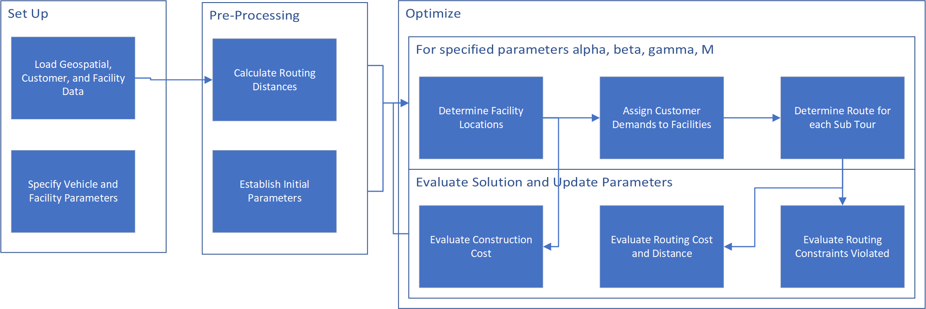
Solution Approach
Motivation
Background
Problem Formulation
Results
Case Study
Discussion
Haoting Ge, Noah Garfinkle, and Ximi Qu | CEE 512: Logistics Systems Analysis | Slide 16 of 40

Slide 17
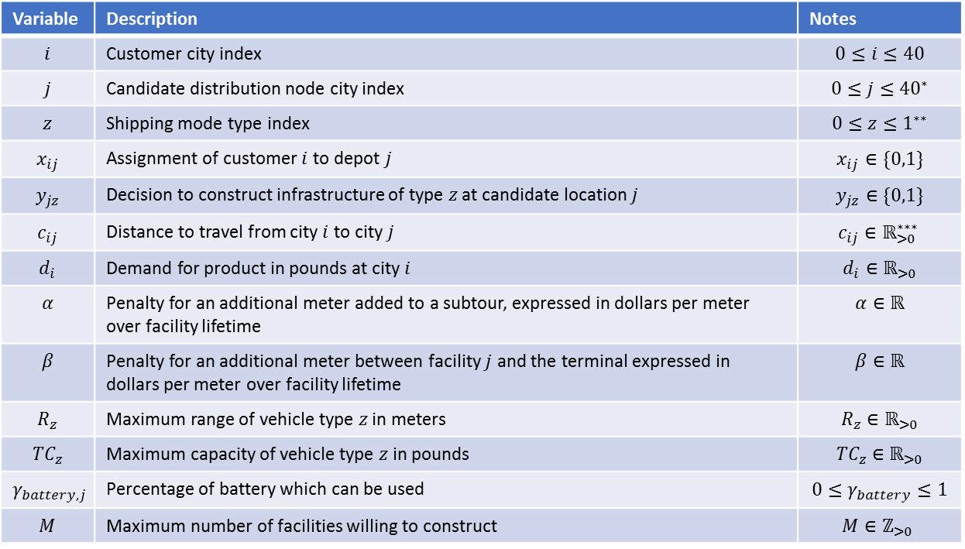
Model Formulation: Variables
Variable | Description | Notes
$$i$$ | Customer city index | $$0≤i≤40$$
$$j$$ | Candidate distribution node city index | $$0≤j≤{40}^{∗}$$
$$z$$ | Shipping mode type index | $$0≤z≤1^{∗∗}$$
$$x_{ij}$$ | Assignment of customer $i$ to depot $j$ | $$x_{ij}∈\{0,1\}$$
$$y_{jz}$$ | Decision to construct infrastructure of type $z$ at candidate location $j$ | $$y_{jz}∈\{0,1\}$$
$$c_{ij}$$ | Distance to travel from city $i$ to city $j$ | $$c_{ij}∈ℝ_{>0}^{∗∗∗}$$
$$d_{i}$$ | Demand for product in pounds at city $i$ | $$d_{i}∈ℝ_{>0}$$
$$α$$ | Penalty for an additional meter added to a subtour, expressed in dollars per meter over facility lifetime | $$α∈ℝ$$
$$β$$ | Penalty for an additional meter between facility $j$ and the terminal expressed in dollars per meter over facility lifetime | $$β∈ℝ$$
$$R_{z}$$ | Maximum range of vehicle type $z$ in meters | $$R_{z}∈ℝ_{>0}$$
$$TC_{z}$$ | Maximum capacity of vehicle type $z$ in pounds | $${TC}_{z}∈ℝ_{>0}$$
$$γ_{battery,j}$$ | Percentage of battery which can be used | $$0≤γ_{battery}≤1$$
$$M$$ | Maximum number of facilities willing to construct | $$M∈ℤ_{>0}$$
Assumptions and Simplifications
The transportation network, demands, and costs are known
Assignment of customer demands can only be to one depot
Each depot serves a single TSP tour
*Each city has a candidate facility
**Standard and extended range vehicle and supporting infrastructure
***Euclidean distance
Motivation
Background
Problem Formulation
Results
Case Study
Discussion
Haoting Ge, Noah Garfinkle, and Ximi Qu | CEE 512: Logistics Systems Analysis | Slide 17 of 40
Notes:
No partial assignments are authorized.
Very simple routing (Euclidean distance, no vehicle limitations, reasonable given inter-city)

Slide 18
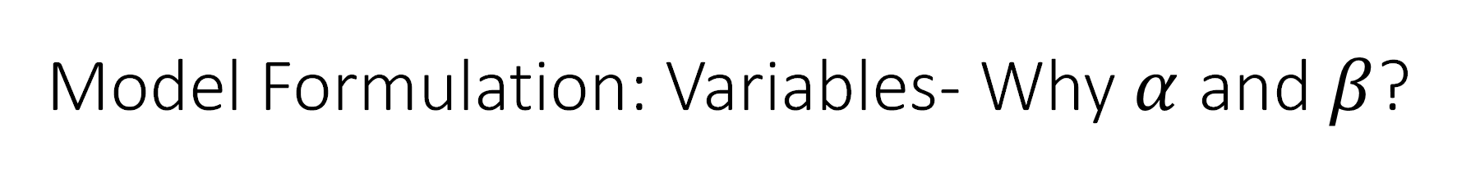
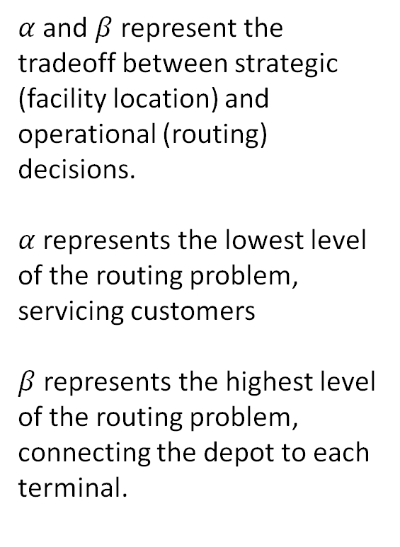
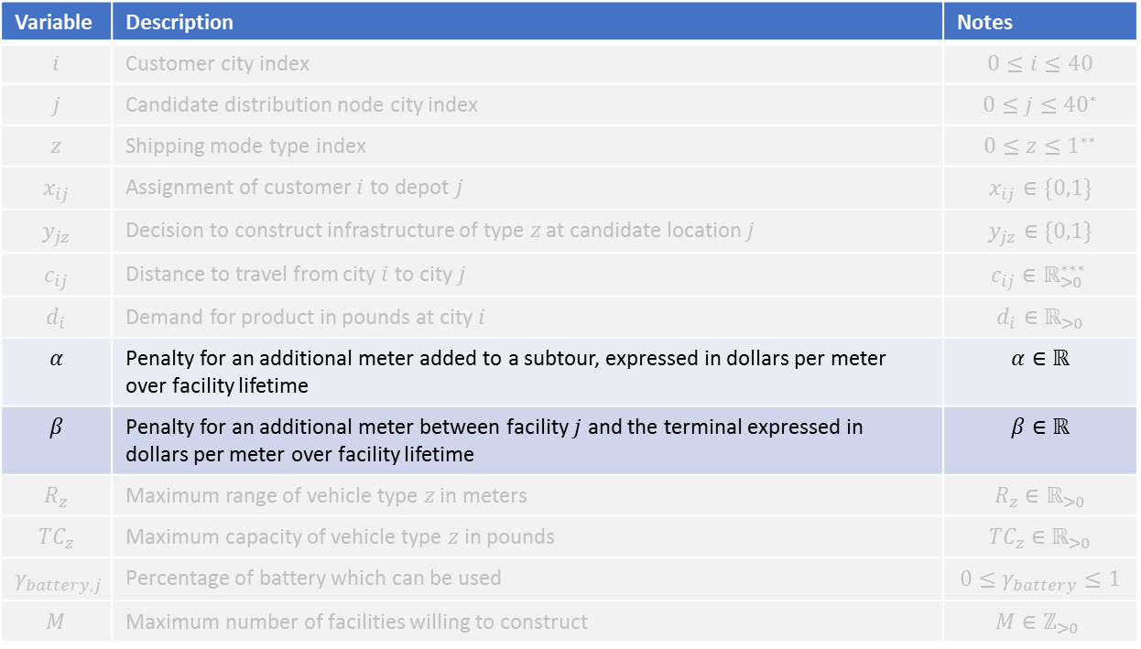
Model Formulation: Variables- Why $α$ and $β$?
Variable | Description | Notes
$$i$$ | Customer city index | $$0≤i≤40$$
$$j$$ | Candidate distribution node city index | $$0≤j≤{40}^{∗}$$
$$z$$ | Shipping mode type index | $$0≤z≤1^{∗∗}$$
$$x_{ij}$$ | Assignment of customer $i$ to depot $j$ | $$x_{ij}∈\{0,1\}$$
$$y_{jz}$$ | Decision to construct infrastructure of type $z$ at candidate location $j$ | $$y_{jz}∈\{0,1\}$$
$$c_{ij}$$ | Distance to travel from city $i$ to city $j$ | $$c_{ij}∈ℝ_{>0}^{∗∗∗}$$
$$d_{i}$$ | Demand for product in pounds at city $i$ | $$d_{i}∈ℝ_{>0}$$
$$α$$ | Penalty for an additional meter added to a subtour, expressed in dollars per meter over facility lifetime | $$α∈ℝ$$
$$β$$ | Penalty for an additional meter between facility $j$ and the terminal expressed in dollars per meter over facility lifetime | $$β∈ℝ$$
$$R_{z}$$ | Maximum range of vehicle type $z$ in meters | $$R_{z}∈ℝ_{>0}$$
$$TC_{z}$$ | Maximum capacity of vehicle type $z$ in pounds | $${TC}_{z}∈ℝ_{>0}$$
$$γ_{battery,j}$$ | Percentage of battery which can be used | $$0≤γ_{battery}≤1$$
$$M$$ | Maximum number of facilities willing to construct | $$M∈ℤ_{>0}$$
$α$ and $β$ represent the tradeoff between strategic (facility location) and operational (routing) decisions.
$α$ represents the lowest level of the routing problem, servicing customers
$β$ represents the highest level of the routing problem, connecting the depot to each terminal.
Motivation
Background
Problem Formulation
Results
Case Study
Discussion
Haoting Ge, Noah Garfinkle, and Ximi Qu | CEE 512: Logistics Systems Analysis | Slide 18 of 40
Notes:
Tradeoff between operational and strategic decision
Othwerise might build facilities where cheapest without consideration for servicing customers
$β$ lets us consider distance from a central depot for resupply, we have set $β=0$ for most of our experiments but this represents an additional level of operational decision making just below strategic

Slide 19
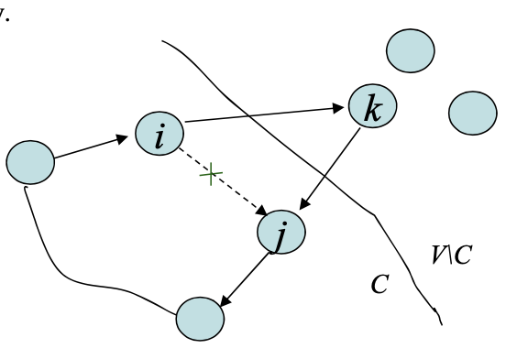
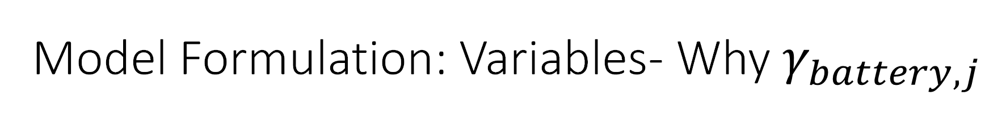
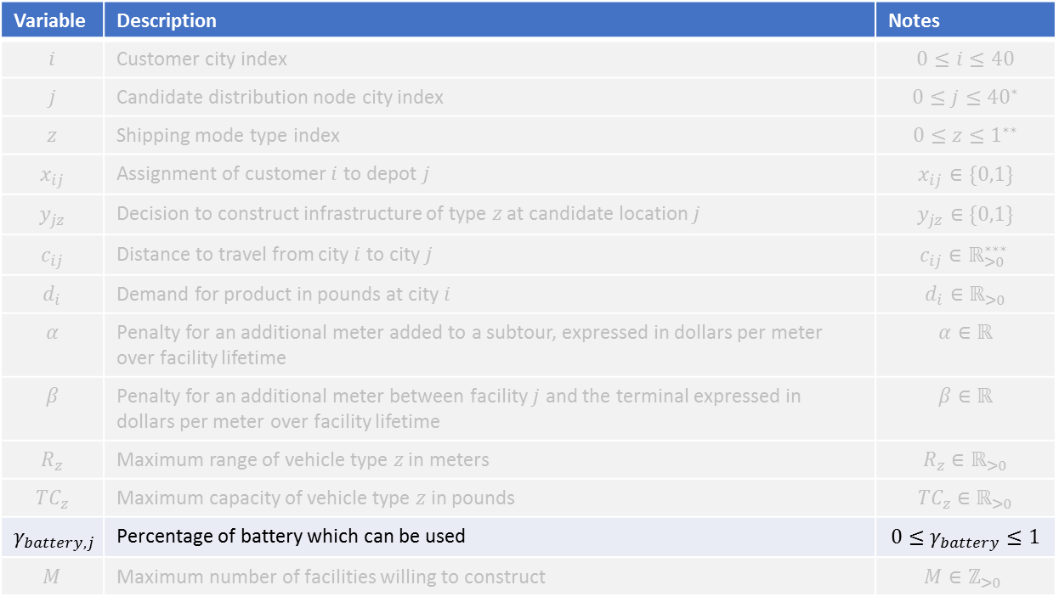
Model Formulation: Variables- Why $γ_{battery,j}$
Variable | Description | Notes
$$i$$ | Customer city index | $$0≤i≤40$$
$$j$$ | Candidate distribution node city index | $$0≤j≤{40}^{∗}$$
$$z$$ | Shipping mode type index | $$0≤z≤1^{∗∗}$$
$$x_{ij}$$ | Assignment of customer $i$ to depot $j$ | $$x_{ij}∈\{0,1\}$$
$$y_{jz}$$ | Decision to construct infrastructure of type $z$ at candidate location $j$ | $$y_{jz}∈\{0,1\}$$
$$c_{ij}$$ | Distance to travel from city $i$ to city $j$ | $$c_{ij}∈ℝ_{>0}^{∗∗∗}$$
$$d_{i}$$ | Demand for product in pounds at city $i$ | $$d_{i}∈ℝ_{>0}$$
$$α$$ | Penalty for an additional meter added to a subtour, expressed in dollars per meter over facility lifetime | $$α∈ℝ$$
$$β$$ | Penalty for an additional meter between facility $j$ and the terminal expressed in dollars per meter over facility lifetime | $$β∈ℝ$$
$$R_{z}$$ | Maximum range of vehicle type $z$ in meters | $$R_{z}∈ℝ_{>0}$$
$$TC_{z}$$ | Maximum capacity of vehicle type $z$ in pounds | $${TC}_{z}∈ℝ_{>0}$$
$$γ_{battery,j}$$ | Percentage of battery which can be used | $$0≤γ_{battery}≤1$$
$$M$$ | Maximum number of facilities willing to construct | $$M∈ℤ_{>0}$$
Motivation
Background
Problem Formulation
Results
Case Study
Discussion
Haoting Ge, Noah Garfinkle, and Ximi Qu | CEE 512: Logistics Systems Analysis | Slide 19 of 40
Notes:
We utilize an insertion heuristic for our clustering, which groups error, particularly in the return leg. By setting this parameter, we can enable more efficient

Slide 20
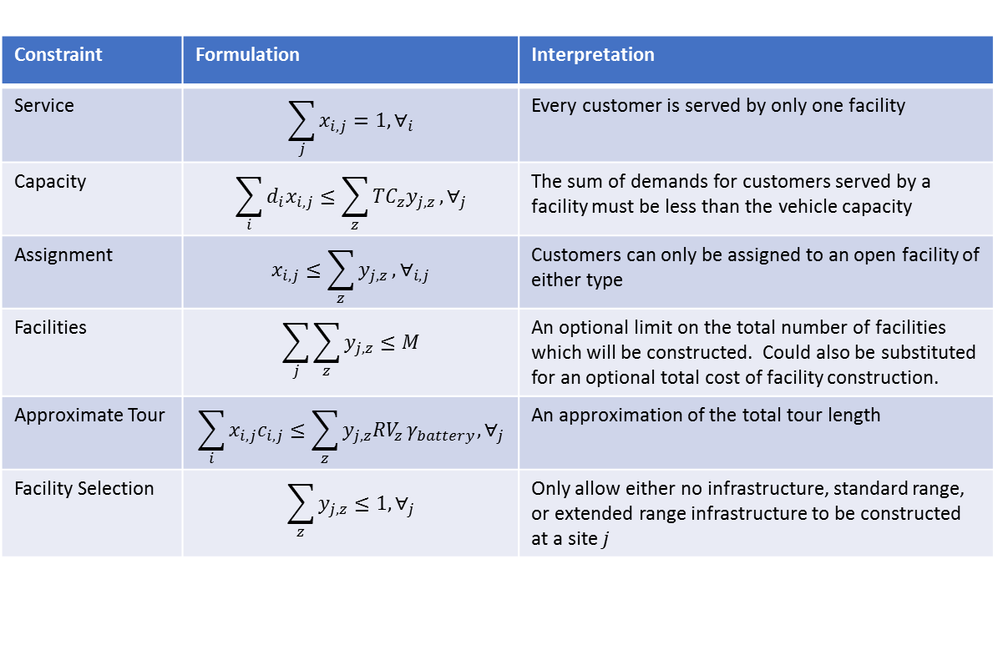
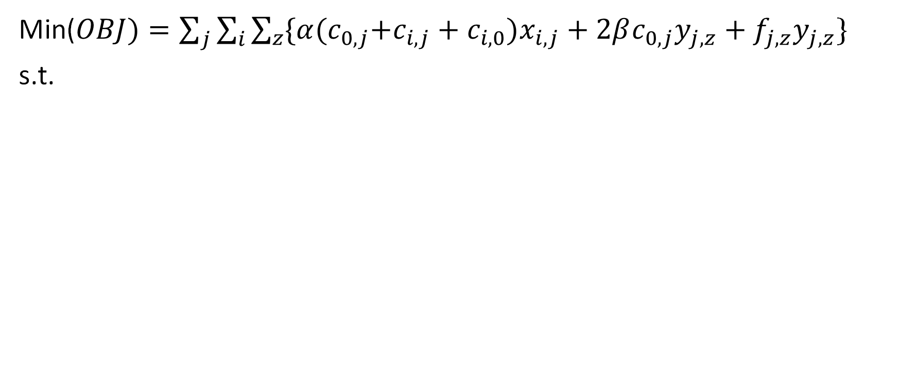
Model Formulation: Facility Location
Min($OBJ)=\sum_{j}{\sum_{i}{\sum_{z}{\{α{(c}_{0,j}+c_{i,j}+c_{i,0}})x_{i,j}}}+2βc_{0,j}y_{j,z}+f_{j,z}y_{j,z}$}
s.t.
Constraint | Formulation | Interpretation
Service | $$\sum_{j}{x_{i,j}}=1,∀_{i}$$ | Every customer is served by only one facility
Capacity | $$\sum_{i}{d_{i}x_{i,j}≤\sum_{z}{TC_{z}y_{j,z}},∀_{j}}$$ | The sum of demands for customers served by a facility must be less than the vehicle capacity
Assignment | $$x_{i,j}≤\sum_{z}{y_{j,z}},∀_{i,j}$$ | Customers can only be assigned to an open facility of either type
Facilities | $$\sum_{j}{\sum_{z}{y_{j,z}}≤M}$$ | An optional limit on the total number of facilities which will be constructed. Could also be substituted for an optional total cost of facility construction.
Approximate Tour | $$\sum_{i}{x_{i,j}c_{i,j}}≤\sum_{z}{y_{j,z}RV_{z}}γ_{battery},∀_{j}$$ | An approximation of the total tour length
Facility Selection | $$\sum_{z}{y_{j,z}≤1,∀_{j}}$$ | Only allow either no infrastructure, standard range, or extended range infrastructure to be constructed at a site $j$
Motivation
Background
Problem Formulation
Results
Case Study
Discussion
Haoting Ge, Noah Garfinkle, and Ximi Qu | CEE 512: Logistics Systems Analysis | Slide 20 of 40

Slide 21
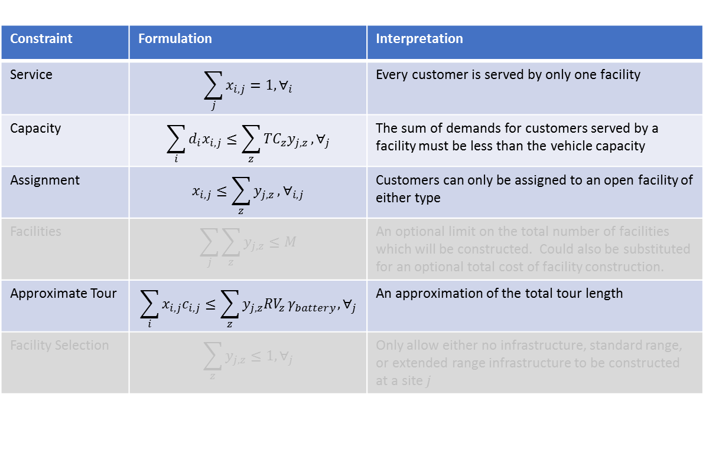
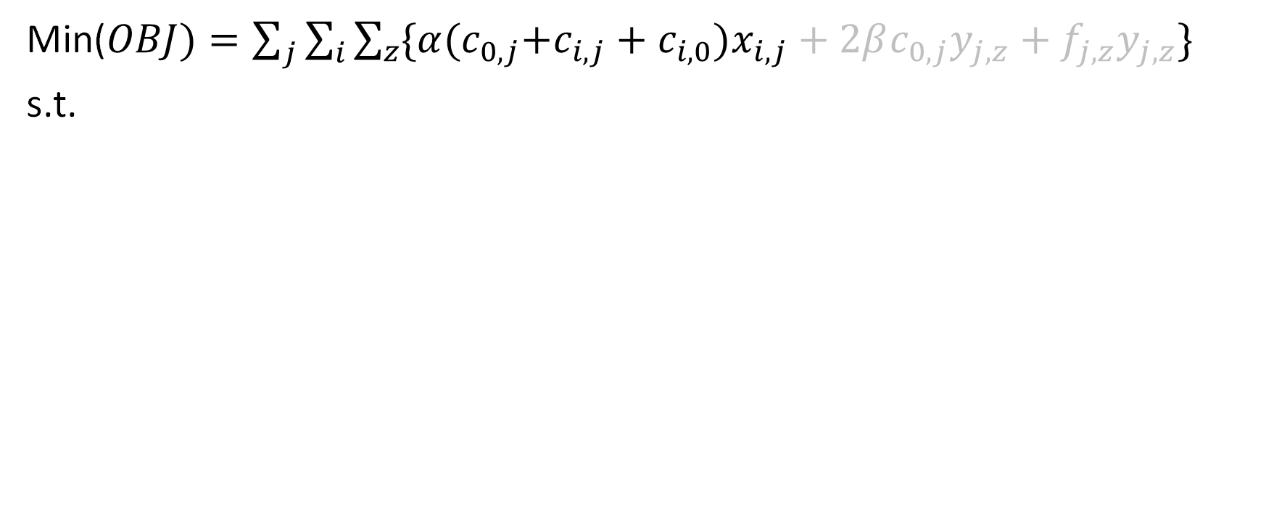
Model Formulation: Facility Location
Min($OBJ)=\sum_{j}{\sum_{i}{\sum_{z}{\{α{(c}_{0,j}+c_{i,j}+c_{i,0}})x_{i,j}}}+2βc_{0,j}y_{j,z}+f_{j,z}y_{j,z}\}$
s.t.
Routing Heuristic
Constraint | Formulation | Interpretation
Service | $$\sum_{j}{x_{i,j}}=1,∀_{i}$$ | Every customer is served by only one facility
Capacity | $$\sum_{i}{d_{i}x_{i,j}≤\sum_{z}{TC_{z}y_{j,z}},∀_{j}}$$ | The sum of demands for customers served by a facility must be less than the vehicle capacity
Assignment | $$x_{i,j}≤\sum_{z}{y_{j,z}},∀_{i,j}$$ | Customers can only be assigned to an open facility of either type
Facilities | $$\sum_{j}{\sum_{z}{y_{j,z}}≤M}$$ | An optional limit on the total number of facilities which will be constructed. Could also be substituted for an optional total cost of facility construction.
Approximate Tour | $$\sum_{i}{x_{i,j}c_{i,j}}≤\sum_{z}{y_{j,z}RV_{z}}γ_{battery},∀_{j}$$ | An approximation of the total tour length
Facility Selection | $$\sum_{z}{y_{j,z}≤1,∀_{j}}$$ | Only allow either no infrastructure, standard range, or extended range infrastructure to be constructed at a site $j$
Motivation
Background
Problem Formulation
Results
Case Study
Discussion
Haoting Ge, Noah Garfinkle, and Ximi Qu | CEE 512: Logistics Systems Analysis | Slide 21 of 40

Slide 22
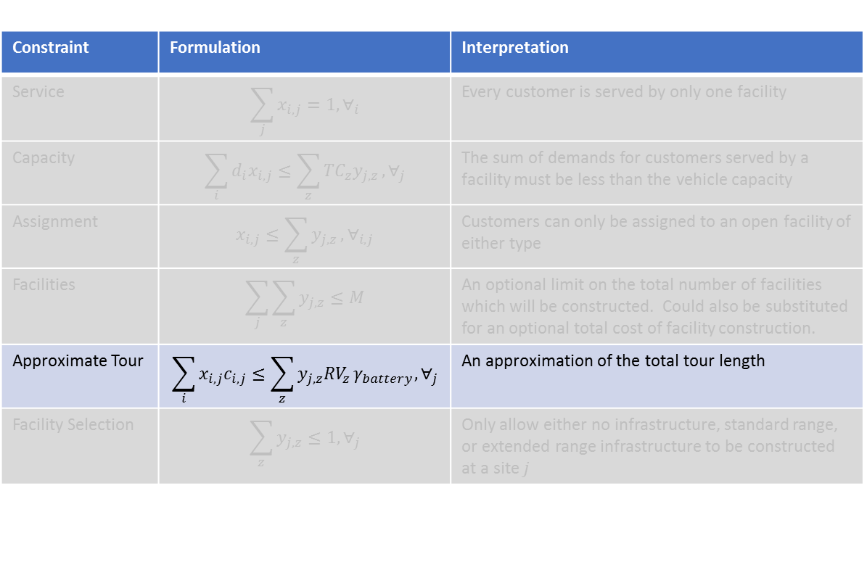
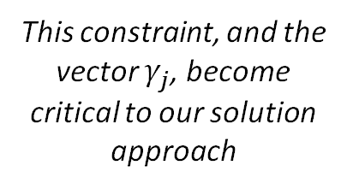
Model Formulation: Facility Location
Min($OBJ)=\sum_{j}{\sum_{i}{\sum_{z}{\{α{(c}_{0,j}+c_{i,j}+c_{i,0}})x_{i,j}}}+2βc_{0,j}y_{j,z}+f_{j,z}y_{j,z}\}$
s.t.
Routing Heuristic
Constraint | Formulation | Interpretation
Service | $$\sum_{j}{x_{i,j}}=1,∀_{i}$$ | Every customer is served by only one facility
Capacity | $$\sum_{i}{d_{i}x_{i,j}≤\sum_{z}{TC_{z}y_{j,z}},∀_{j}}$$ | The sum of demands for customers served by a facility must be less than the vehicle capacity
Assignment | $$x_{i,j}≤\sum_{z}{y_{j,z}},∀_{i,j}$$ | Customers can only be assigned to an open facility of either type
Facilities | $$\sum_{j}{\sum_{z}{y_{j,z}}≤M}$$ | An optional limit on the total number of facilities which will be constructed. Could also be substituted for an optional total cost of facility construction.
Approximate Tour | $$\sum_{i}{x_{i,j}c_{i,j}}≤\sum_{z}{y_{j,z}RV_{z}}γ_{battery},∀_{j}$$ | An approximation of the total tour length
Facility Selection | $$\sum_{z}{y_{j,z}≤1,∀_{j}}$$ | Only allow either no infrastructure, standard range, or extended range infrastructure to be constructed at a site $j$
This constraint, and the vector $γ_{j}$, become critical to our solution approach
Motivation
Background
Problem Formulation
Results
Case Study
Discussion
Haoting Ge, Noah Garfinkle, and Ximi Qu | CEE 512: Logistics Systems Analysis | Slide 22 of 40

Slide 23
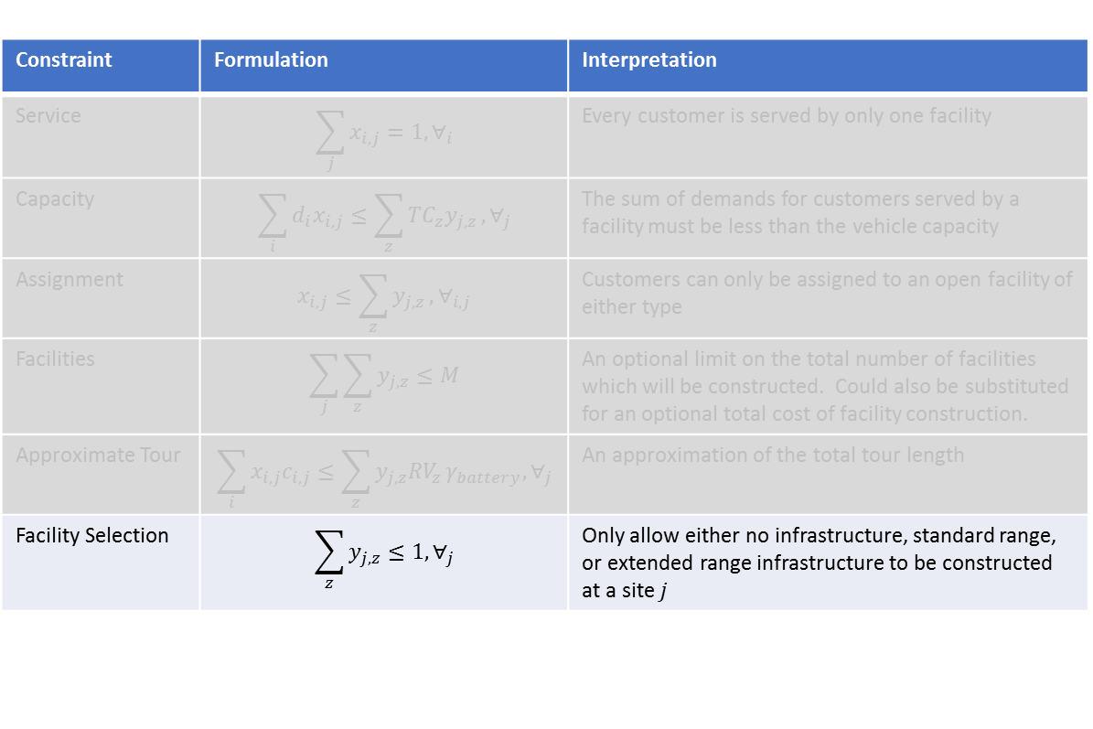
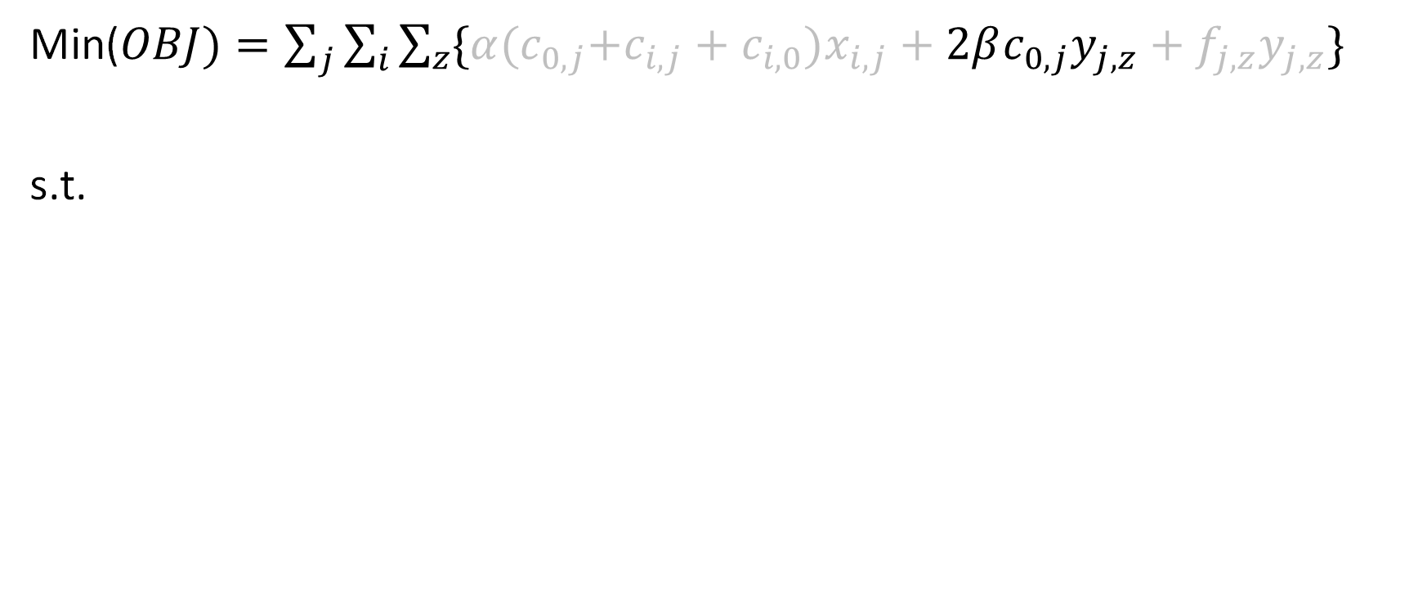
Model Formulation: Facility Location
Min($OBJ)=\sum_{j}{\sum_{i}{\sum_{z}{\{α{(c}_{0,j}+c_{i,j}+c_{i,0}})x_{i,j}}}+2βc_{0,j}y_{j,z}+f_{j,z}y_{j,z}\}$
s.t.
Terminal Heuristic
Constraint | Formulation | Interpretation
Service | $$\sum_{j}{x_{i,j}}=1,∀_{i}$$ | Every customer is served by only one facility
Capacity | $$\sum_{i}{d_{i}x_{i,j}≤\sum_{z}{TC_{z}y_{j,z}},∀_{j}}$$ | The sum of demands for customers served by a facility must be less than the vehicle capacity
Assignment | $$x_{i,j}≤\sum_{z}{y_{j,z}},∀_{i,j}$$ | Customers can only be assigned to an open facility of either type
Facilities | $$\sum_{j}{\sum_{z}{y_{j,z}}≤M}$$ | An optional limit on the total number of facilities which will be constructed. Could also be substituted for an optional total cost of facility construction.
Approximate Tour | $$\sum_{i}{x_{i,j}c_{i,j}}≤\sum_{z}{y_{j,z}RV_{z}}γ_{battery},∀_{j}$$ | An approximation of the total tour length
Facility Selection | $$\sum_{z}{y_{j,z}≤1,∀_{j}}$$ | Only allow either no infrastructure, standard range, or extended range infrastructure to be constructed at a site $j$
Motivation
Background
Problem Formulation
Results
Case Study
Discussion
Haoting Ge, Noah Garfinkle, and Ximi Qu | CEE 512: Logistics Systems Analysis | Slide 23 of 40

Slide 24
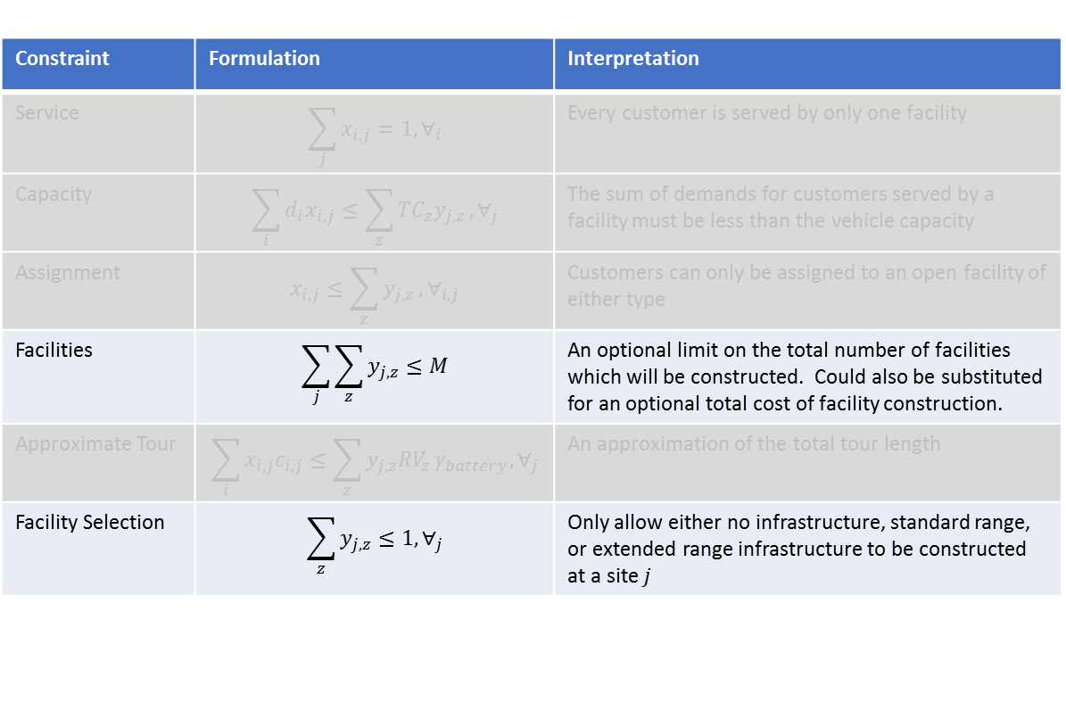
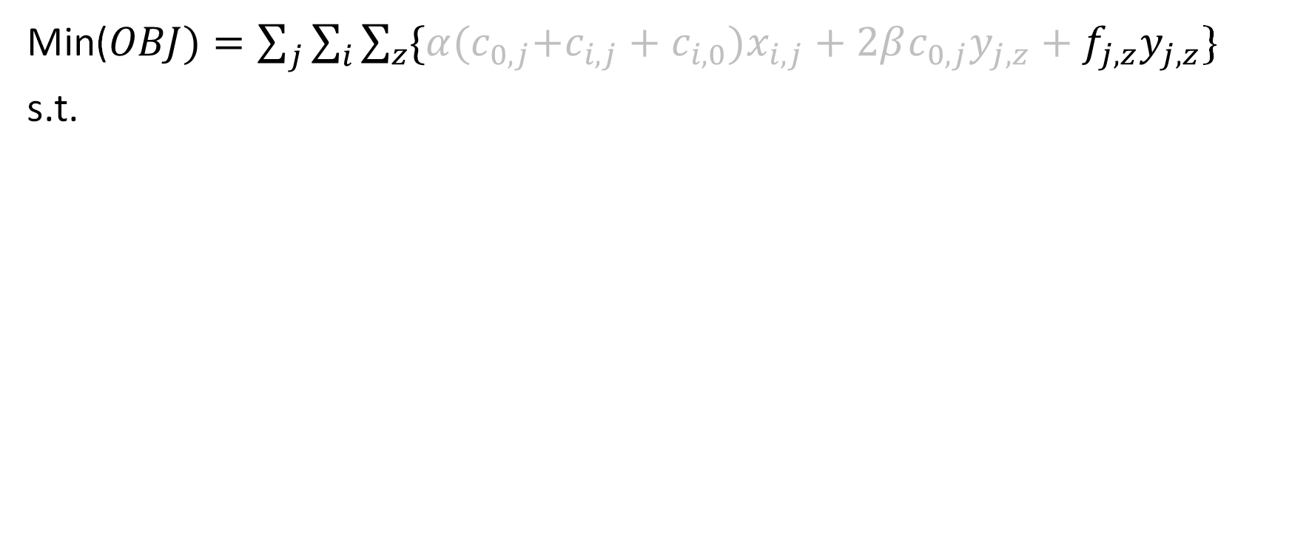
Model Formulation: Facility Location
Min($OBJ)=\sum_{j}{\sum_{i}{\sum_{z}{\{α{(c}_{0,j}+c_{i,j}+c_{i,0}})x_{i,j}}}+2βc_{0,j}y_{j,z}+f_{j,z}y_{j,z}$}
s.t.
Facility Cost
Constraint | Formulation | Interpretation
Service | $$\sum_{j}{x_{i,j}}=1,∀_{i}$$ | Every customer is served by only one facility
Capacity | $$\sum_{i}{d_{i}x_{i,j}≤\sum_{z}{TC_{z}y_{j,z}},∀_{j}}$$ | The sum of demands for customers served by a facility must be less than the vehicle capacity
Assignment | $$x_{i,j}≤\sum_{z}{y_{j,z}},∀_{i,j}$$ | Customers can only be assigned to an open facility of either type
Facilities | $$\sum_{j}{\sum_{z}{y_{j,z}}≤M}$$ | An optional limit on the total number of facilities which will be constructed. Could also be substituted for an optional total cost of facility construction.
Approximate Tour | $$\sum_{i}{x_{i,j}c_{i,j}}≤\sum_{z}{y_{j,z}RV_{z}}γ_{battery},∀_{j}$$ | An approximation of the total tour length
Facility Selection | $$\sum_{z}{y_{j,z}≤1,∀_{j}}$$ | Only allow either no infrastructure, standard range, or extended range infrastructure to be constructed at a site $j$
Motivation
Background
Problem Formulation
Results
Case Study
Discussion
Haoting Ge, Noah Garfinkle, and Ximi Qu | CEE 512: Logistics Systems Analysis | Slide 24 of 40

Slide 25
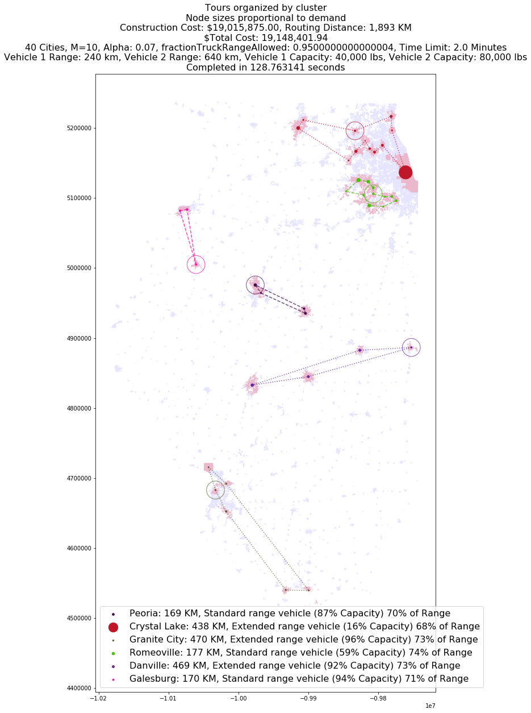
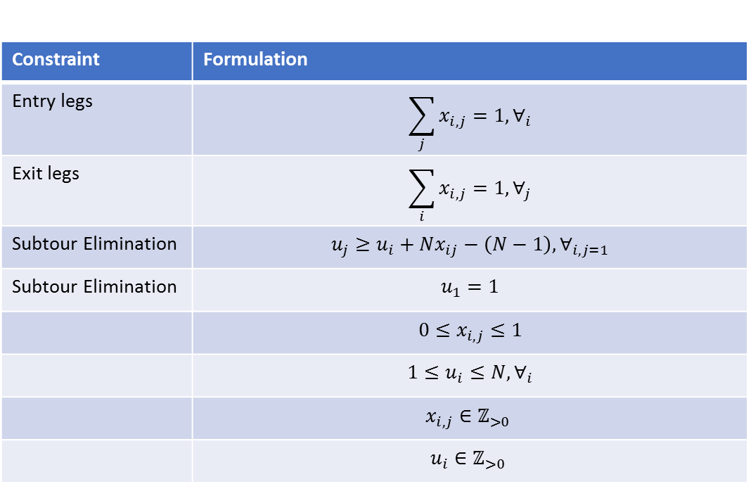
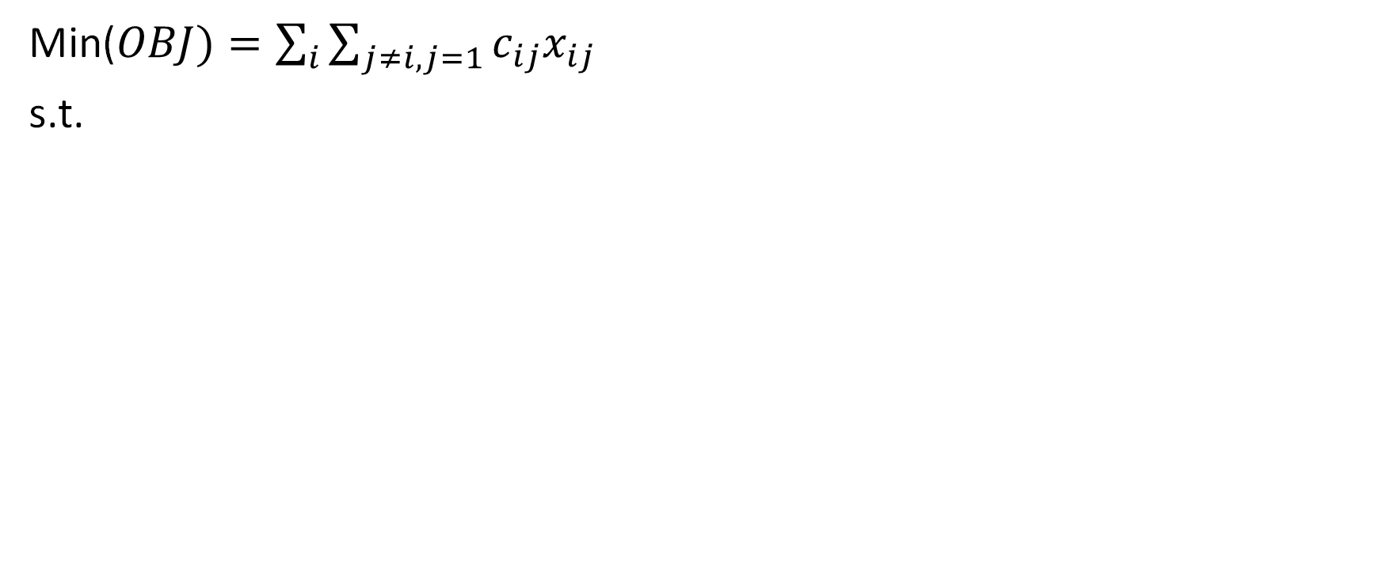
Model Formulation: Routing
Min($OBJ)=\sum_{i}{\sum_{j≠i,j=1}{c_{ij}x_{ij}}}$
s.t.
Because our tours are generally small, solutions are generated using the routing libraries within ORTOOLS utilizing default parameters.
Constraint | Formulation
Entry legs | $$\sum_{j}{x_{i,j}}=1,∀_{i}$$
Exit legs | $$\sum_{i}{x_{i,j}}=1,∀_{j}$$
Subtour Elimination | $$u_{j}≥u_{i}+Nx_{ij}−\left(N−1\right),∀_{i,j=1}$$
Subtour Elimination | $$u_{1}=1$$
 | $$0≤x_{i,j}≤1$$
 | $$1≤u_{i}≤N,∀_{i}$$
 | $$x_{i,j}∈ℤ_{>0}$$
 | $$u_{i}∈ℤ_{>0}$$
Motivation
Background
Problem Formulation
Results
Case Study
Discussion
Haoting Ge, Noah Garfinkle, and Ximi Qu | CEE 512: Logistics Systems Analysis | Slide 25 of 40

Slide 26
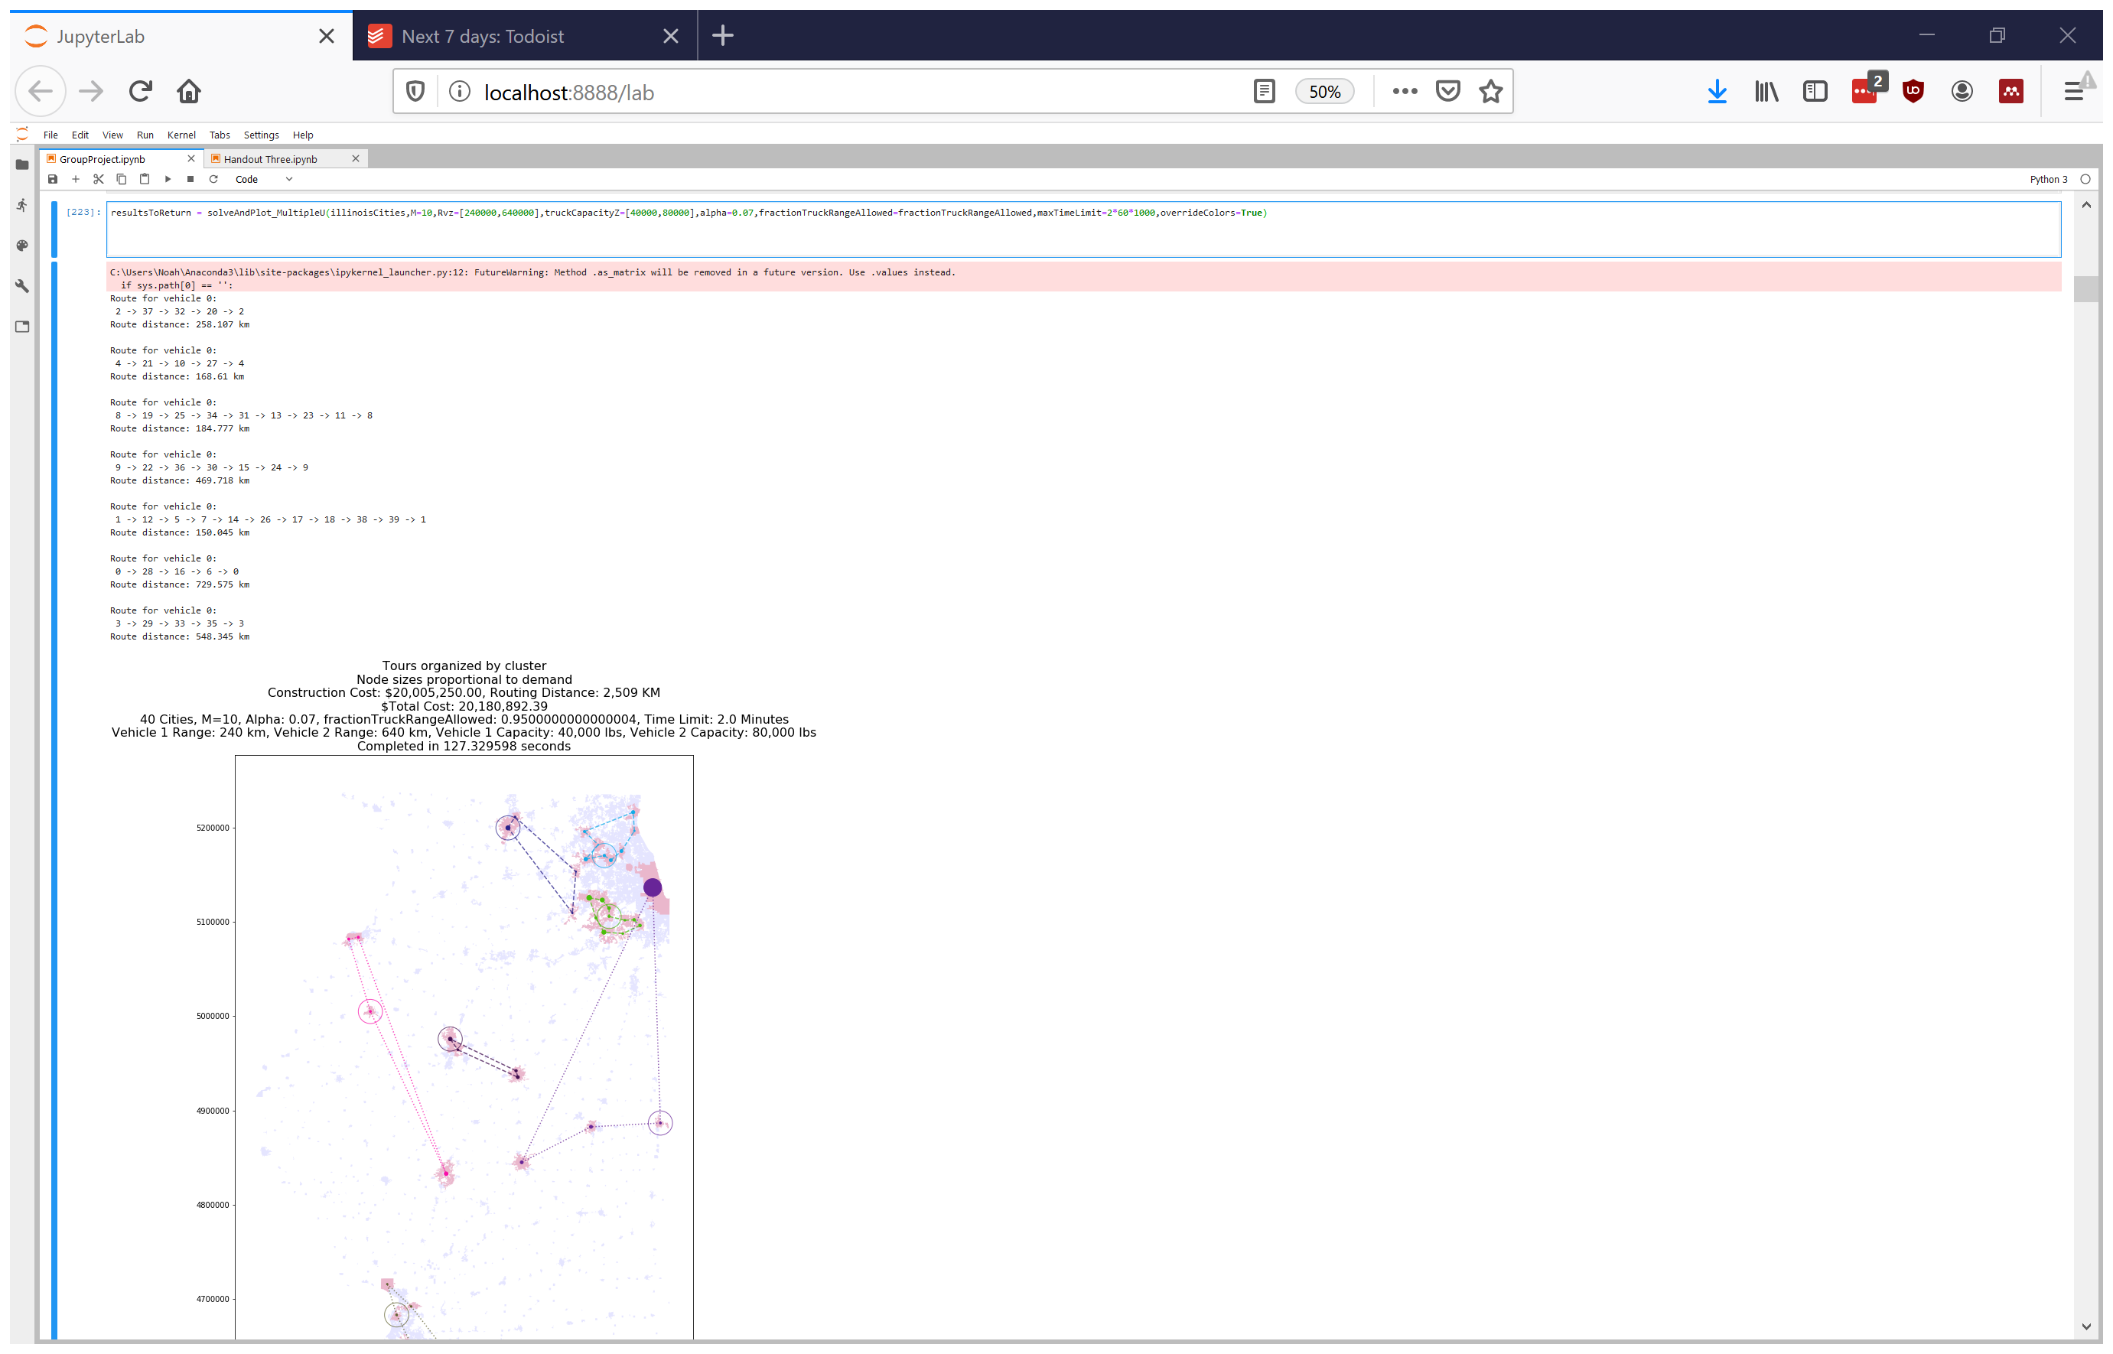




Model Solution
Models formulated using Python 3.6
Numerical optimization utilizes ORTOOLS library
Motivation
Background
Problem Formulation
Results
Case Study
Discussion
Haoting Ge, Noah Garfinkle, and Ximi Qu | CEE 512: Logistics Systems Analysis | Slide 26 of 40

Slide 27
Results
Motivation
Background
Problem Formulation
Results
Case Study
Discussion
Haoting Ge, Noah Garfinkle, and Ximi Qu | CEE 512: Logistics Systems Analysis | Slide 27 of 40

Slide 28
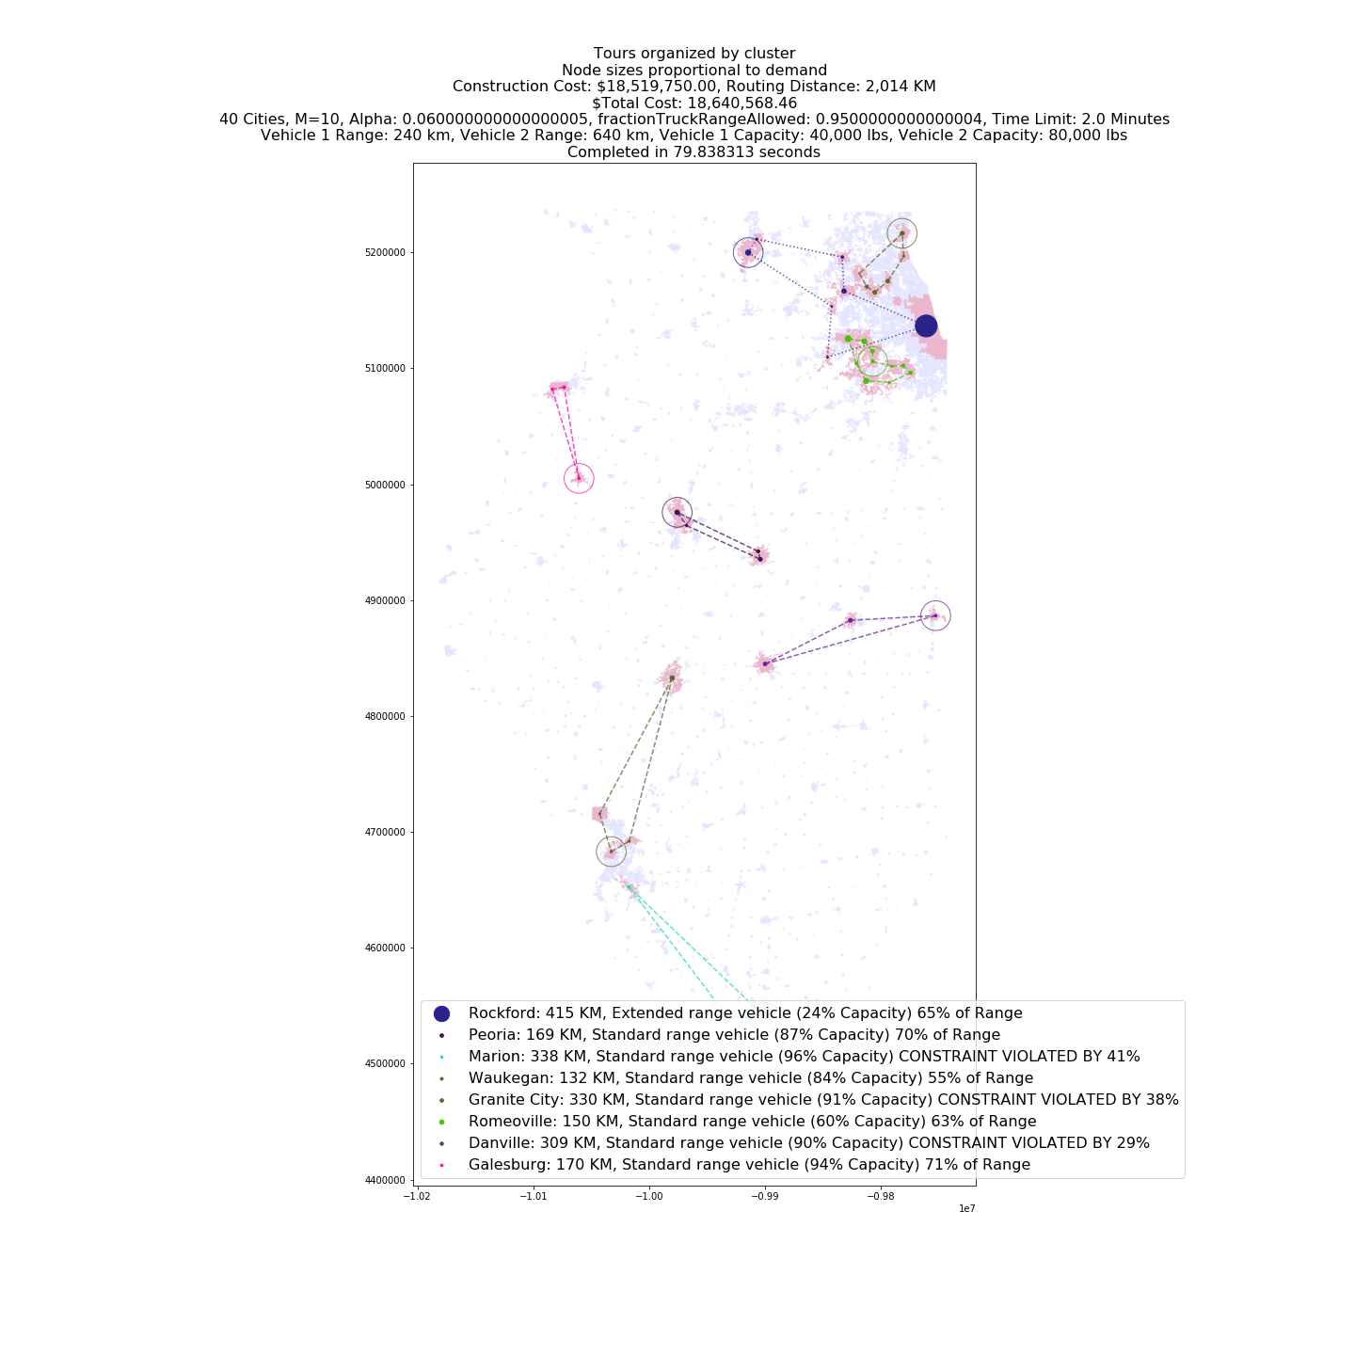
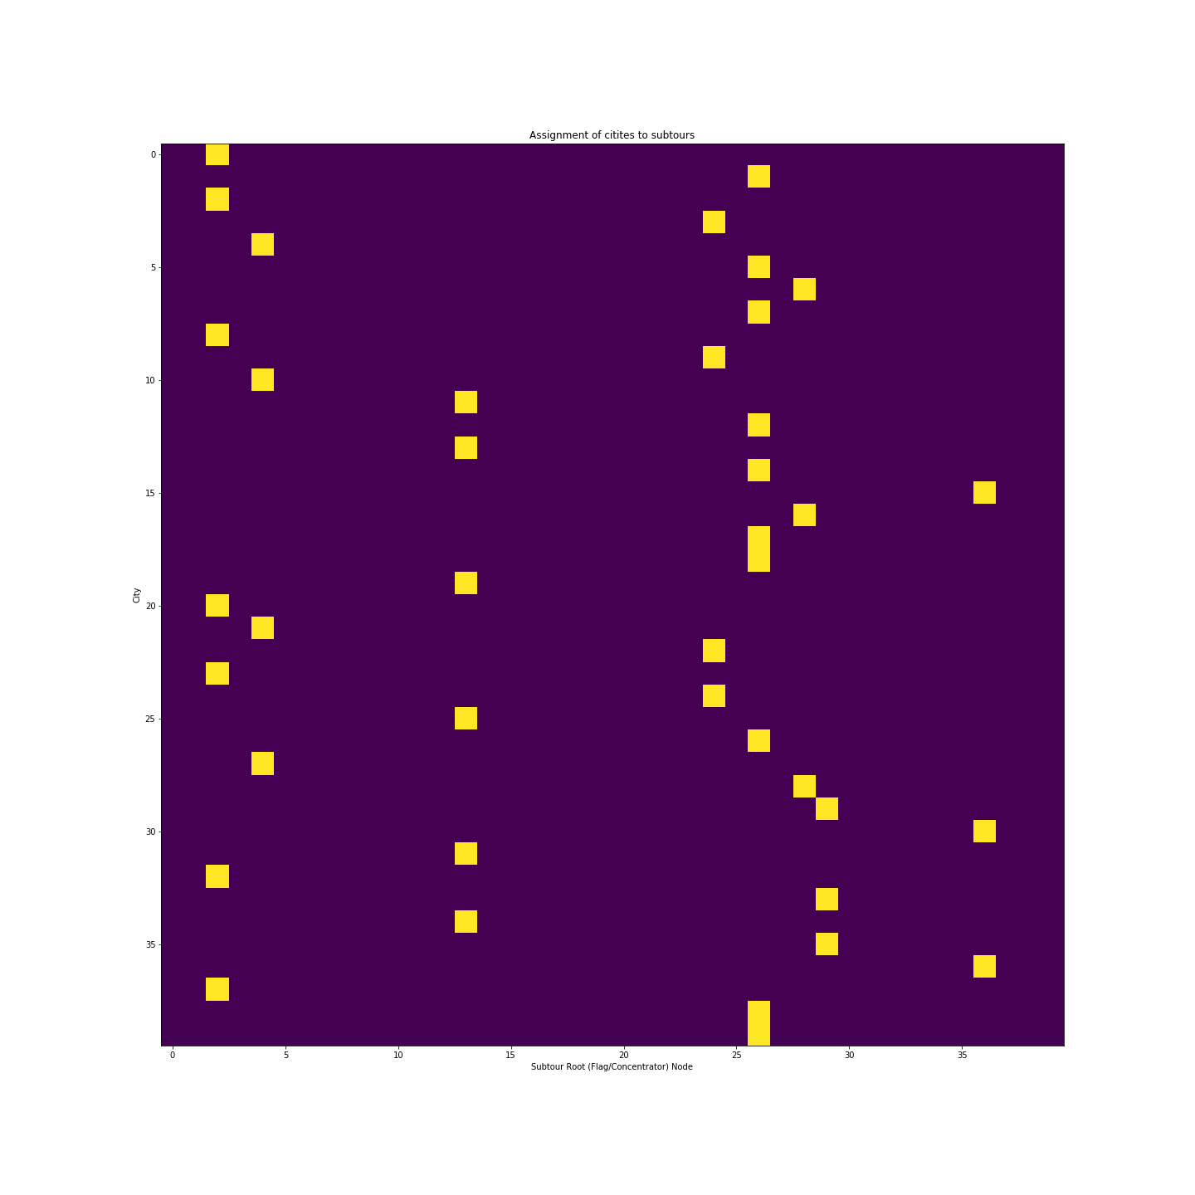
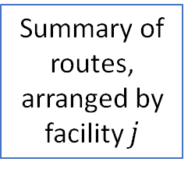
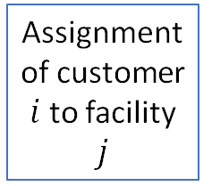
Guide to Interpreting Our Results
Objective functions
Routes:
Circles: Depots
Dashed: Standard EV
Dotted: Extended Range EV
Assignment of customer $i$ to facility $j$
Constraint violations
Summary of routes, arranged by facility $j$
Motivation
Background
Problem Formulation
Results
Case Study
Discussion
Haoting Ge, Noah Garfinkle, and Ximi Qu | CEE 512: Logistics Systems Analysis | Slide 28 of 40
Notes:
Noah

Slide 29
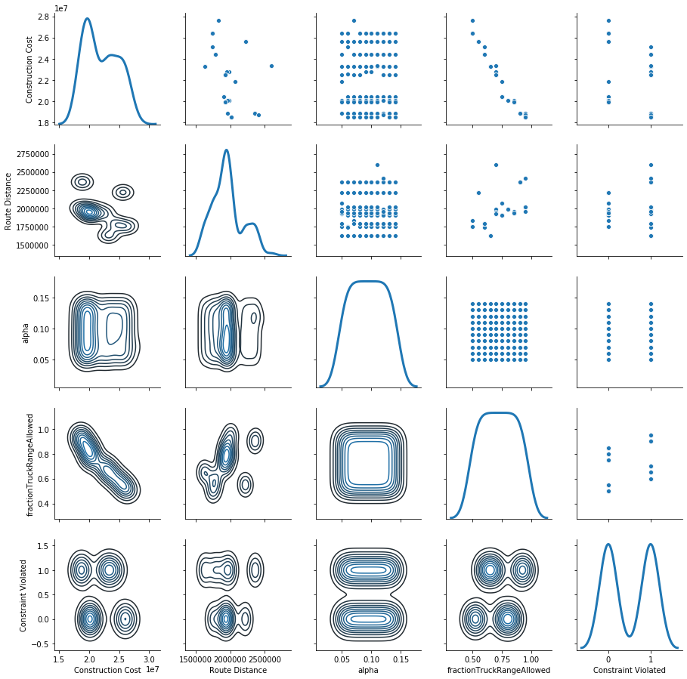

Heuristic 1: Study model sensitivity to $α,γ_{battery}$
Motivation
Background
Problem Formulation
Results
Case Study
Discussion
Haoting Ge, Noah Garfinkle, and Ximi Qu | CEE 512: Logistics Systems Analysis | Slide 29 of 40

Slide 30

Heuristic 1: Study model sensitivity to $α,γ_{battery}$
Motivation
Background
Problem Formulation
Results
Case Study
Discussion
Haoting Ge, Noah Garfinkle, and Ximi Qu | CEE 512: Logistics Systems Analysis | Slide 30 of 40

Slide 31
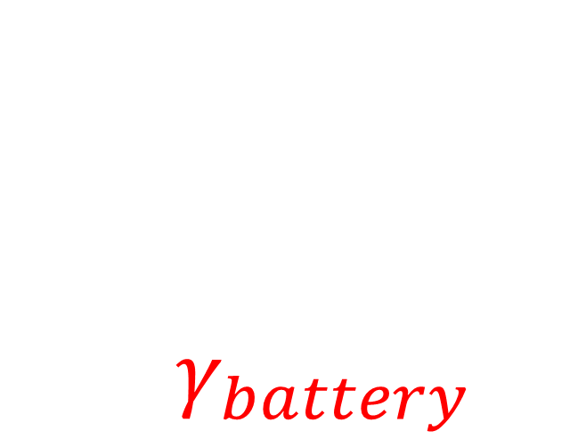
Heuristic 1: Study model sensitivity to $α,γ_{battery}$
Motivation
Background
Problem Formulation
Results
Case Study
Discussion
Haoting Ge, Noah Garfinkle, and Ximi Qu | CEE 512: Logistics Systems Analysis | Slide 31 of 40

Slide 32
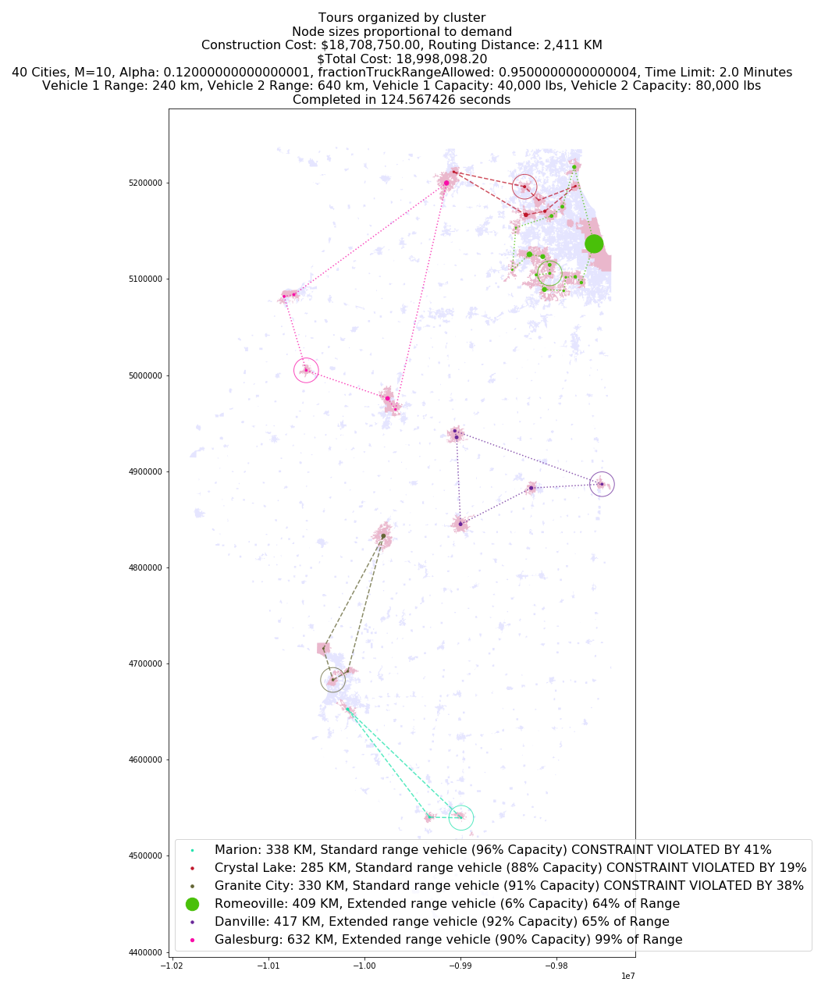
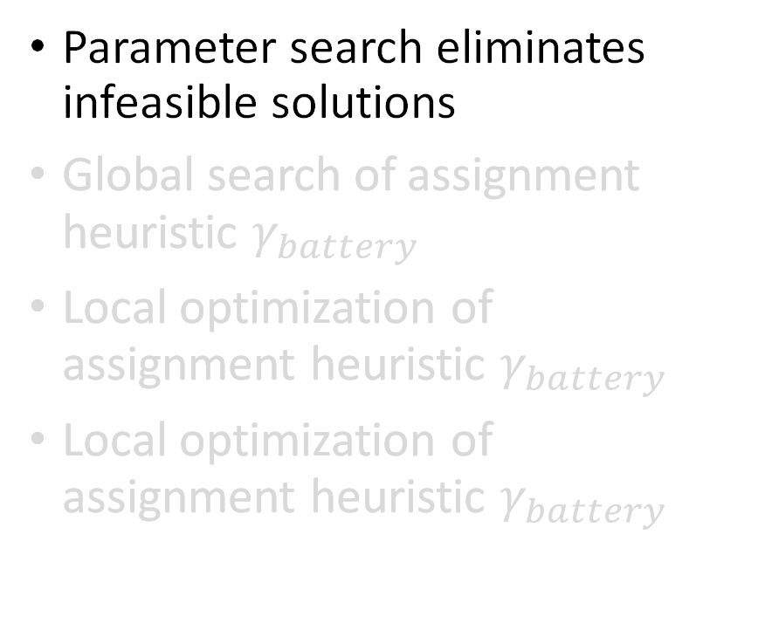
Solution Found
Parameter search eliminates infeasible solutions
Global search of assignment heuristic $γ_{battery}$
Local optimization of assignment heuristic $γ_{battery}$
Local optimization of assignment heuristic $γ_{battery}$
Motivation
Background
Problem Formulation
Results
Case Study
Discussion
Haoting Ge, Noah Garfinkle, and Ximi Qu | CEE 512: Logistics Systems Analysis | Slide 32 of 40

Slide 33
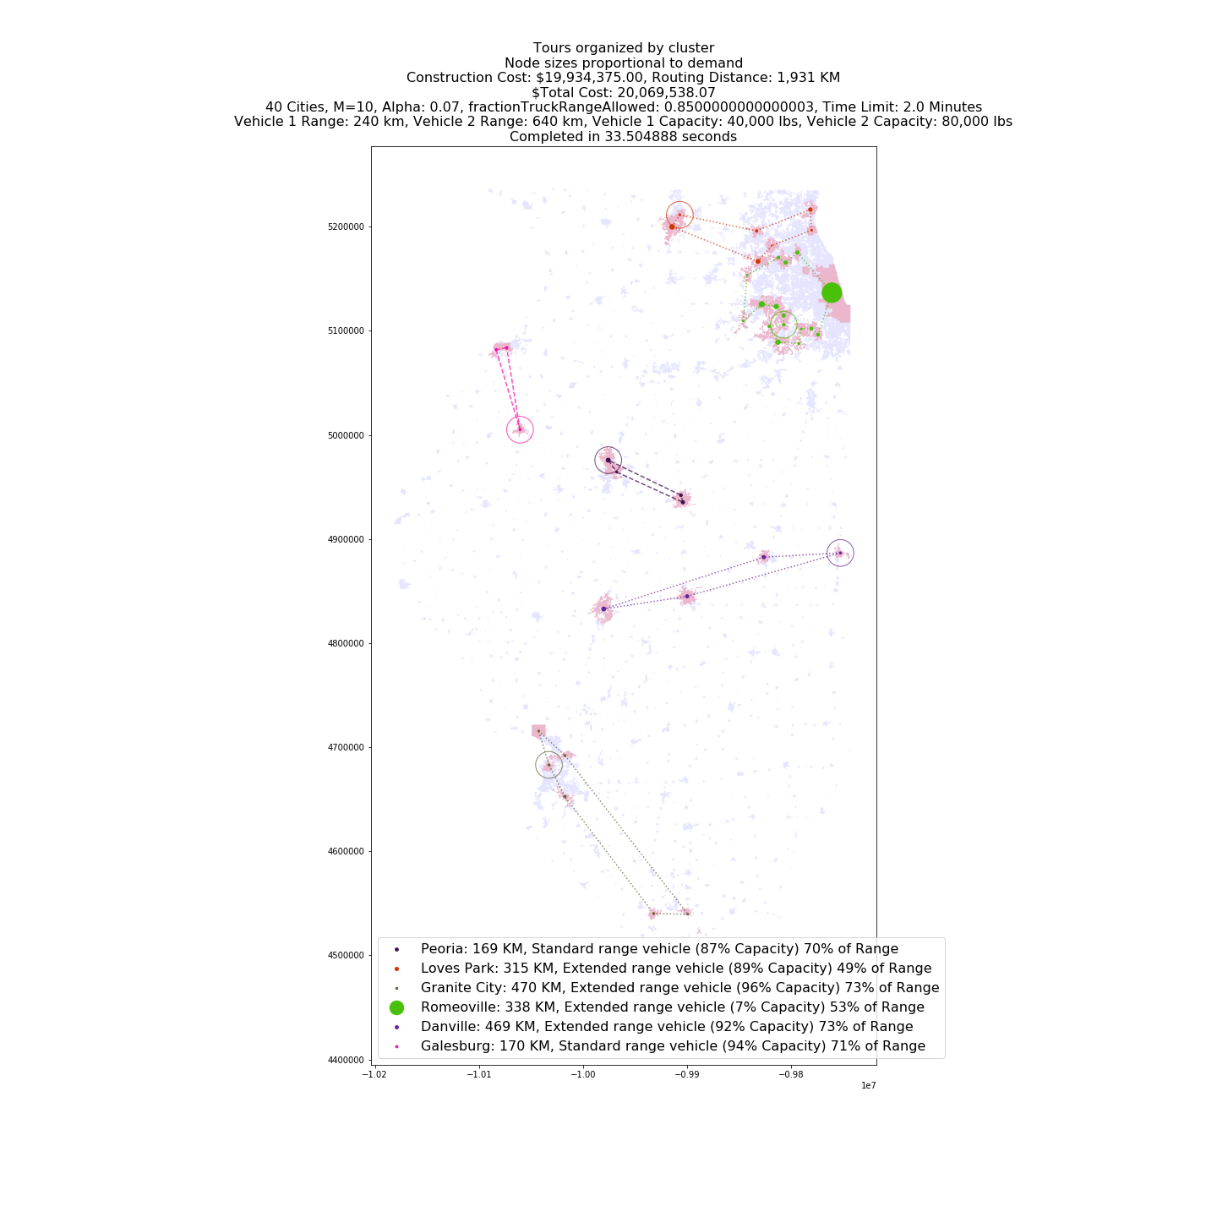
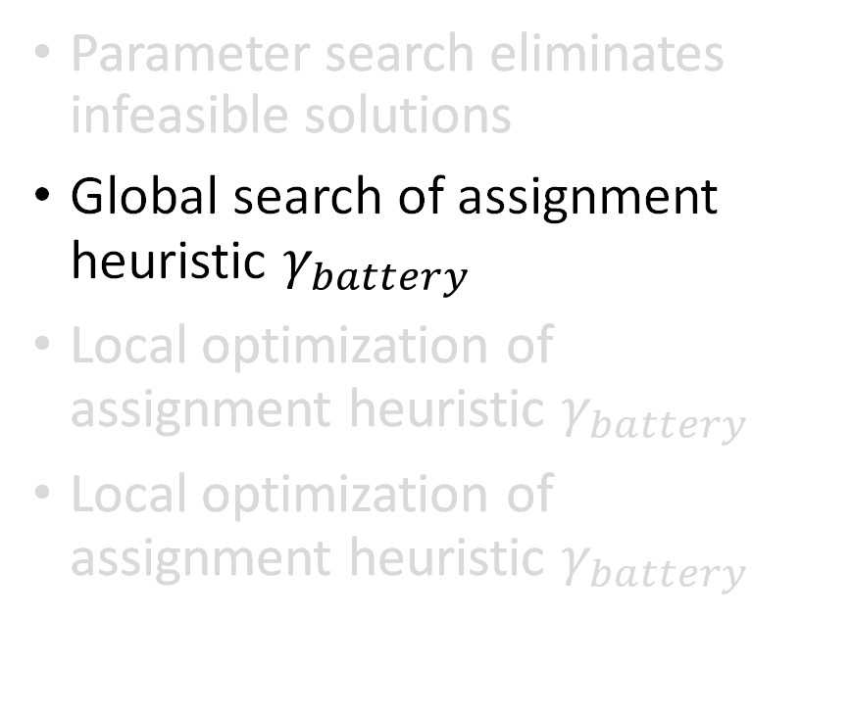
Solution Found
Parameter search eliminates infeasible solutions
Global search of assignment heuristic $γ_{battery}$
Local optimization of assignment heuristic $γ_{battery}$
Local optimization of assignment heuristic $γ_{battery}$
Motivation
Background
Problem Formulation
Results
Case Study
Discussion
Haoting Ge, Noah Garfinkle, and Ximi Qu | CEE 512: Logistics Systems Analysis | Slide 33 of 40

Slide 34

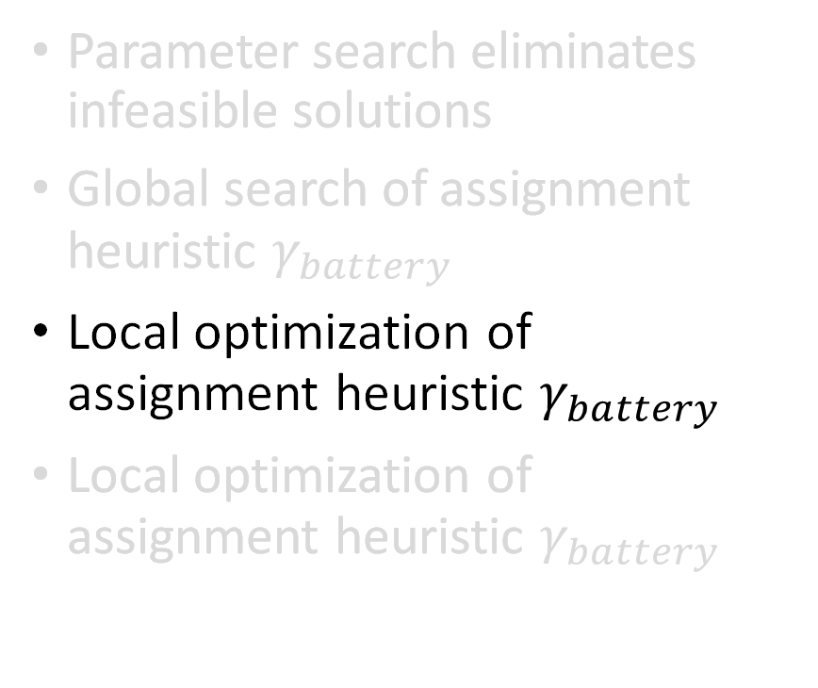
Solution Found
Parameter search eliminates infeasible solutions
Global search of assignment heuristic $γ_{battery}$
Local optimization of assignment heuristic $γ_{battery}$
Local optimization of assignment heuristic $γ_{battery}$
Motivation
Background
Problem Formulation
Results
Case Study
Discussion
Haoting Ge, Noah Garfinkle, and Ximi Qu | CEE 512: Logistics Systems Analysis | Slide 34 of 40

Slide 35
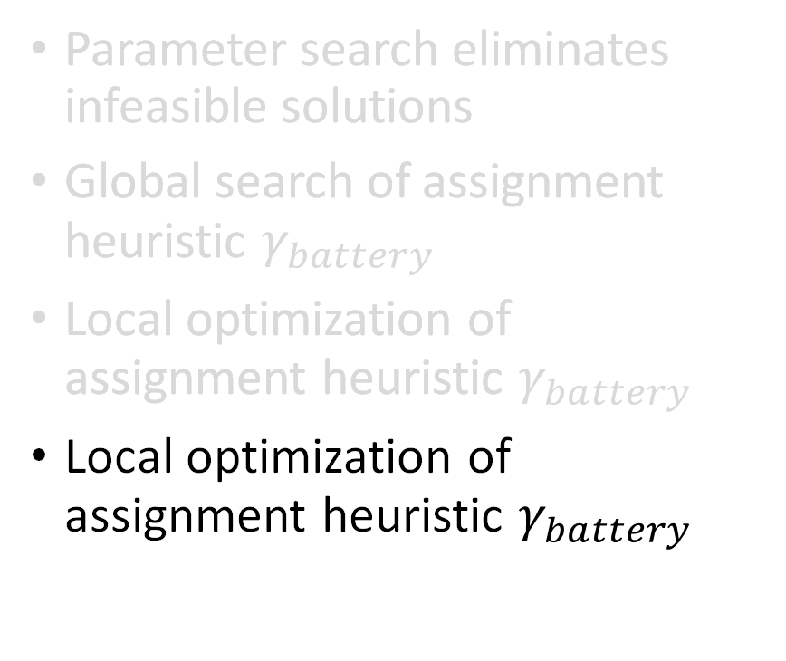
Solution Found
Parameter search eliminates infeasible solutions
Global search of assignment heuristic $γ_{battery}$
Local optimization of assignment heuristic $γ_{battery}$
Local optimization of assignment heuristic $γ_{battery}$
Motivation
Background
Problem Formulation
Results
Case Study
Discussion
Haoting Ge, Noah Garfinkle, and Ximi Qu | CEE 512: Logistics Systems Analysis | Slide 35 of 40

Slide 36
Discussion
Motivation
Background
Problem Formulation
Results
Case Study
Discussion
Haoting Ge, Noah Garfinkle, and Ximi Qu | CEE 512: Logistics Systems Analysis | Slide 36 of 40
Notes:
Haoting

Slide 37
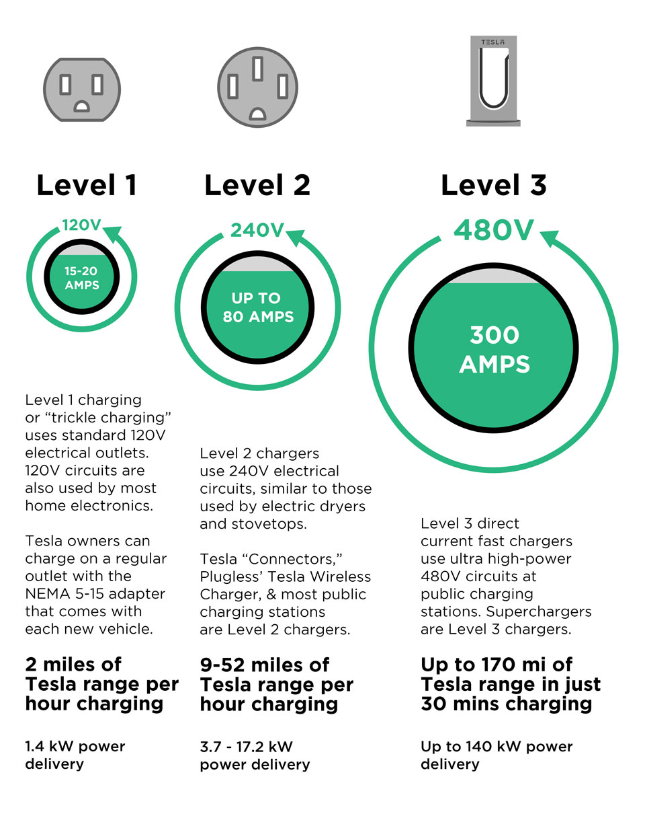
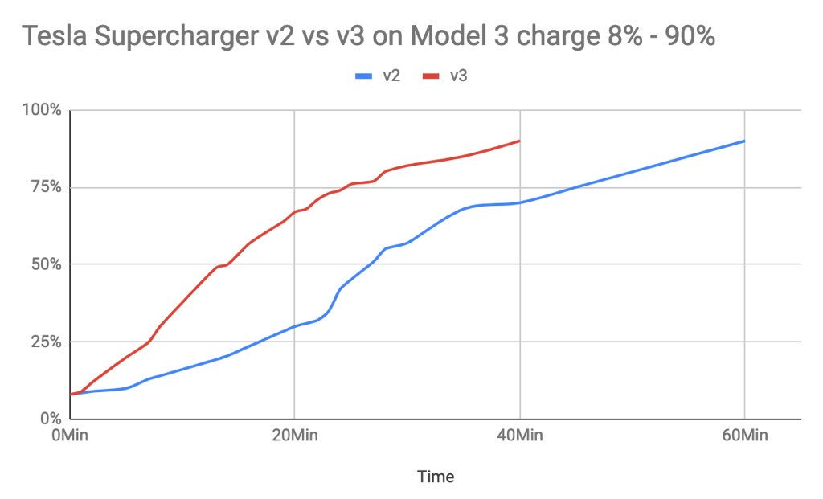
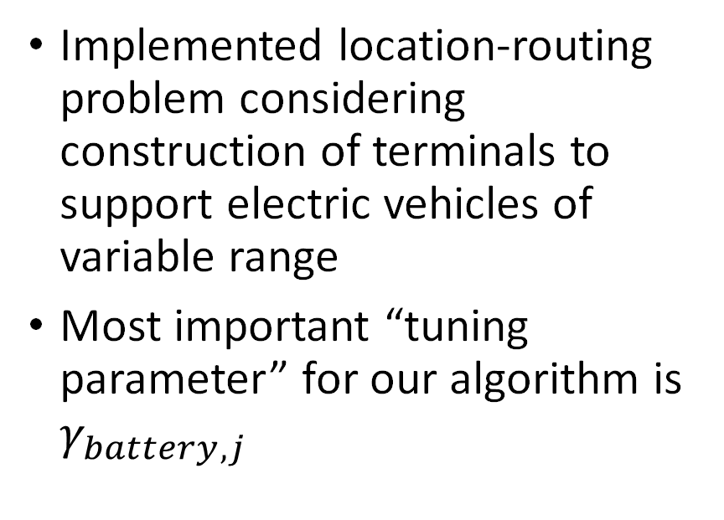
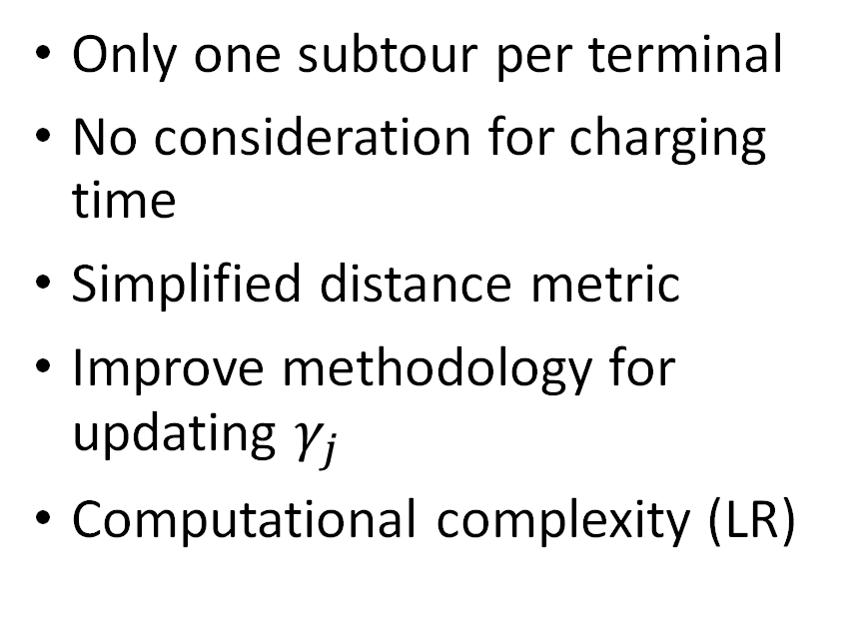
Discussion
Conclusions
Limitations and Proposed Future Work
Implemented location-routing problem considering construction of terminals to support electric vehicles of variable range
Most important “tuning parameter” for our algorithm is $γ_{battery,j}$
Only one subtour per terminal
No consideration for charging time
Simplified distance metric
Improve methodology for updating $γ_{j}$
Computational complexity (LR)
Motivation
Background
Problem Formulation
Results
Case Study
Discussion
Haoting Ge, Noah Garfinkle, and Ximi Qu | CEE 512: Logistics Systems Analysis | Slide 37 of 40
Notes:
Computational bottleneck is in clustering problem, would benefit from Lagrangian Relaxation (our algorithm took about 6 hours to generate the solution presented for the 40 node problem) but was not written for efficient updating per above

Slide 38
References
[1] https://missionfinancialservices.net/fully-electric-semi-trucks-the-future-of-trucking/
[2] He, Fang, et al. "Optimal deployment of public charging stations for plug-in hybrid electric vehicles." Transportation Research Part B: Methodological 47 (2013): 87-91.
[3] The Location Optimization of Electric Vehicle Charging Stations Considering Charging Behavior- Tian, Hou, Gu, Gu, and Yao, 2018 (Simulation)
[4] Zhang, K., Lu, L., Lei, C., Zhu, H., & Ouyang, Y. (2018). Dynamic operations and pricing of electric unmanned aerial vehicle systems and power networks. Transportation Research Part C: Emerging Technologies, 92, 472-485.
Motivation
Background
Problem Formulation
Results
Case Study
Discussion
Haoting Ge, Noah Garfinkle, and Ximi Qu | CEE 512: Logistics Systems Analysis | Slide 38 of 40

Slide 39
References
[5] Laporte G., Nobert Y., Pelletier P. (1983). Hamiltonian Location Problems. Eur J Oper Res, 12(1), 82–89.
[6] Laporte G., Dejax P.J. (1989). Dynamic location-routing problems. Journal of the Operational Research Society, 40(5), 471-482.
Motivation
Background
Problem Formulation
Results
Case Study
Discussion
Haoting Ge, Noah Garfinkle, and Ximi Qu | CEE 512: Logistics Systems Analysis | Slide 39 of 40

Slide 40
Thank you for your time!
We welcome any questions. And cannot give discounts.

Slide 41
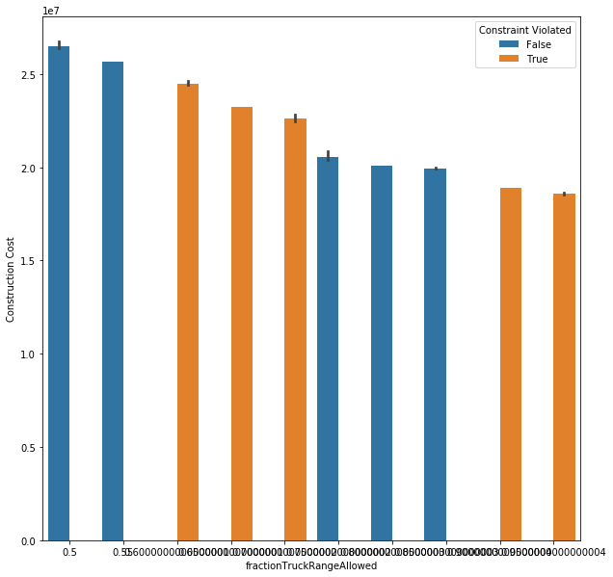
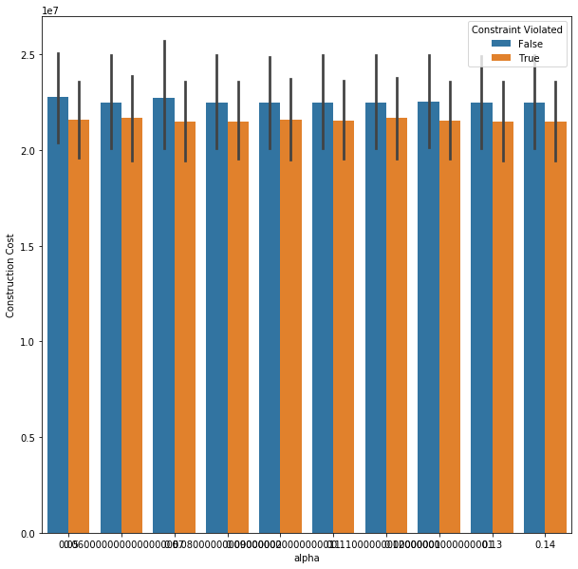
Parameter search identifies that our solution is sensitive to battery but not to alpha. This makes sense, because alpha is correlated to our TSP heuristic constraint

